Slide 1
Strategies for managing genetic disorders in dairy cattle
John B. Cole
USDA, Agricultural Research Service
Henry A. Wallace Beltsville Agricultural Research Center
Animal Genomics and Improvement Laboratory
Beltsville, MD 20705-2350
john.cole@ars.usda.gov

Slide 2

Well, here we are

Slide 3
Overview
Introduction to genetic disorders
Definition
Examples
Impact on farmers
Management of genetic disorders
Conventional breeding
Gene editing
Desirable alleles

Slide 4
Introduction to genetic disorders

Slide 5
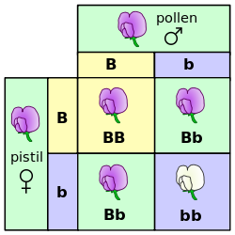
Mendelian recessives
Classical model of inheritance
One locus, typically with two alleles
Often exhibit complete dominance
e.g., Mendel’s experiments
Source: https://commons.wikimedia.org/wiki/File:Punnett_square_mendel_flowers.svg.

Slide 6
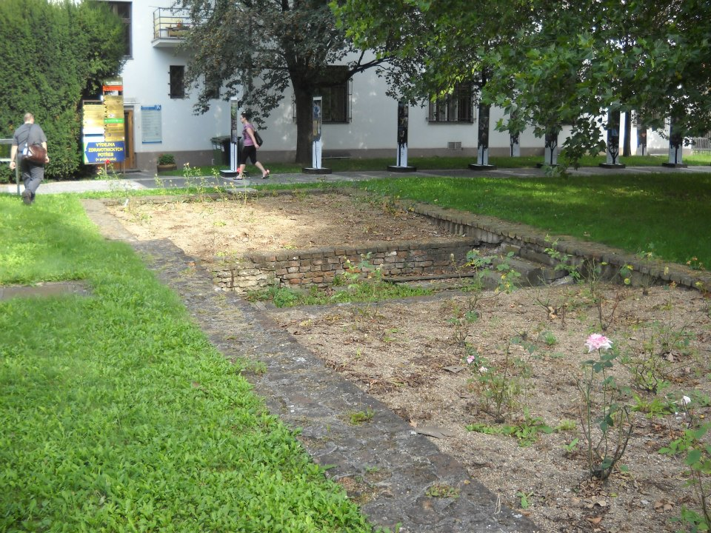
A pilgrimage, of sorts
Source: Author.

Slide 7
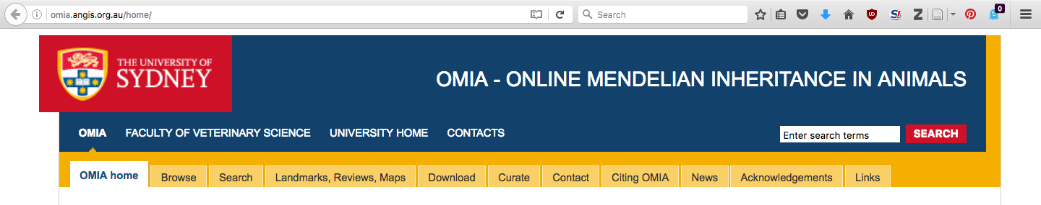
Genetic diseases are common
There are currently 494 genetic traits/disorders of cattle in the Online Mendelian Inheritance in Animals database
http://omia.angis.org.au/home/
229 of these are Mendelian traits/disorders

Slide 8
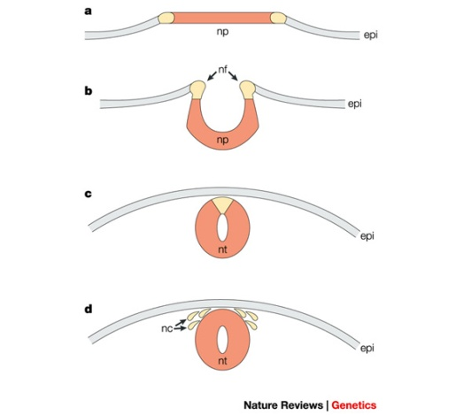
Example – APAF1 (HH1)
Bos taurus apoptotic peptidase activating factor 1 (APAF1; Adams et al., 2016)
Gene expression for APAF1 in murine development begins between 7 and 9 d (Müller et al., 2005)
Gene knockout of APAF1 results in embryonic death
Proteins required for this pathway/cascade are important for neural tube closure in vivo

Slide 9
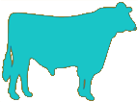

Transmission of APAF1
100% free of recessives | 50% free, 50% carriers
50% free, 50% carriers | 25% free, 50% carriers, 25% die
Source: http://vet.tufts.edu/tas/images/002.png.

Slide 10
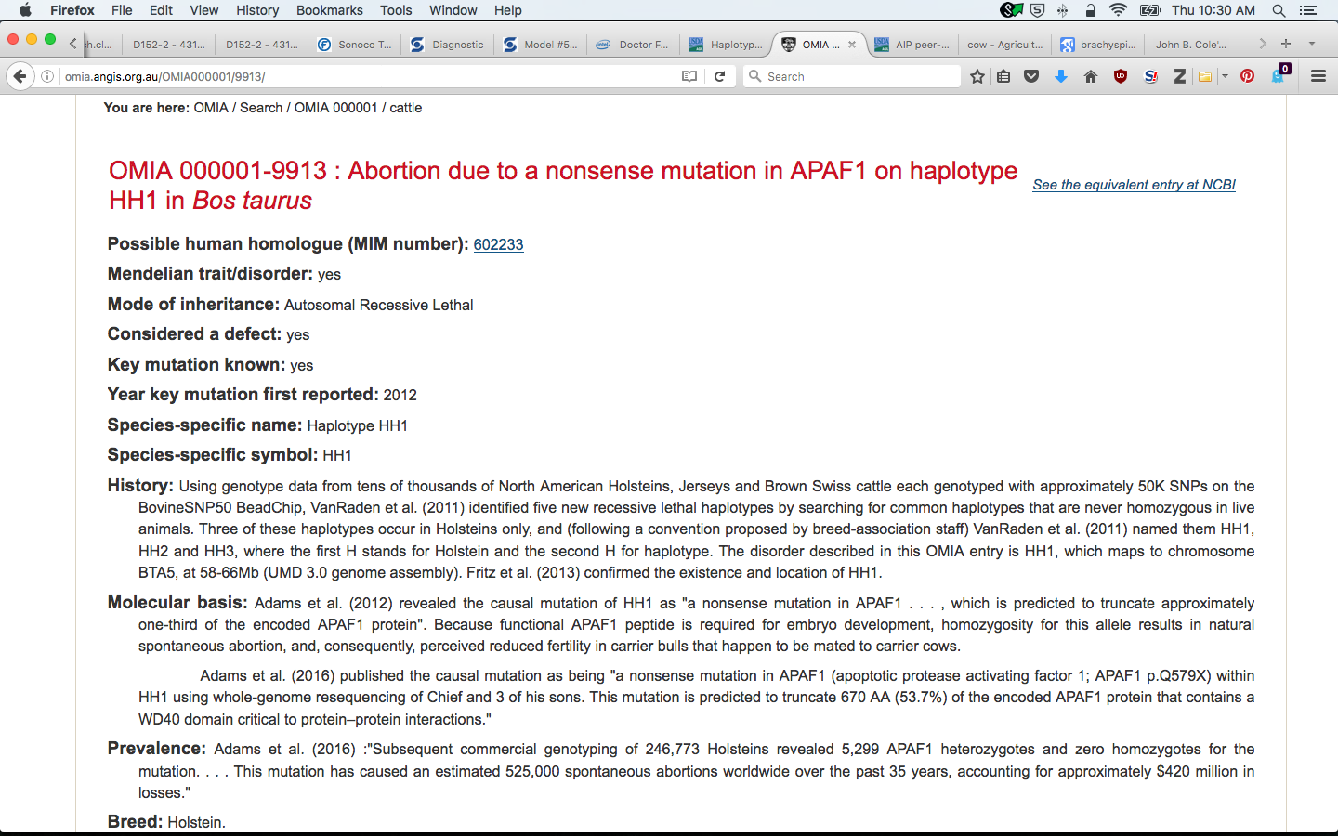
OMIA cards for APAF1
Source: http://omia.angis.org.au/OMIA000001/9913/.

Slide 11
Brachyspina (FANC1)
Source: Agerholm et al. (2006).

Slide 12
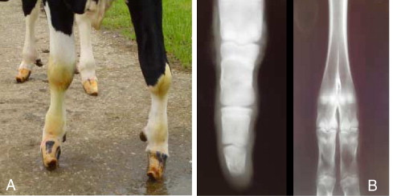
Syndactyly (Mulefoot)
Source: Duchesne et al. (2006).

Slide 13
Timing of recessive effects
Late losses are more costly than early losses
A defect may cause deaths in more than one time period
Embryonic loss or abortion | Death at or near birth | Weeks or months following birth
BH1, HH0, HH1, HH2, HH3, HH4, HH5, CVM, JH1, JH2 | BH2, HH0, CVM, syndactyly (mulefoot) | AH1, BH2, BLAD, cholesterol deficiency, spinal dysmyelination, spinal muscular atrophy, weaver syndrome

Slide 14
Haplotypes affecting fertility
Rapid discovery of new recessive defects
Large numbers of genotyped animals
Affordable DNA sequencing
Determination of haplotype location
Significant number of homozygous animals expected, but none observed
Narrow suspect region with fine mapping
Use sequence data to find causative mutation

Slide 15
Genotypes are plentiful

Slide 16
Recessives in U.S. Holsteins
Haplo- type | Functional/Gene name | BTA chromosome | Location (Mbp) | Haplotype frequency (%) | Timing¹
HBR | Black/red coat color/MC1R(MSHR) | 18 | 14.8 | 0.80 | —
HCD | Cholesterol deficiency/APOB | 11 | 78.0* | 2.50 | W
HDR | Dominant red color/MC1R(MSHR) | 3 | 9.5* | 0.04 | —
HH0 | Brachyspina/FANCI | 21 | 21.2 | 2.76 | E,B
HH1 | APAF1 | 5 | 63.2* | 1.92 | E
HH2 | — | 1 | 94.9 – 96.6 | 1.66 | E
HH3 | SMC2 | 8 | 95.4* | 2.95 | E
HH4 | GART | 1 | 1.3* | 0.37 | E
HH5 | TFB1M | 9 | 93.2 – 93.4 | 2.22 | E
HHB | BLAD/ITGB2 | 1 | 145.1* | 0.25 | W
HHC | CVM/SLC35A3 | 3 | 43.4* | 1.37 | E,B
HHD | DUMPS/UMPS | 1 | 69.8* | 0.01 | E
HHM | Mule foot/LRP4 | 15 | 77.7 | 0.07 | B
HHP | Polledness (dominant)/POLLED | 1 | 1.7 – 2.0 | 0.71 | —
HHR | Red coat color/MC1R(MSHR) | 18 | 14.8* | 5.42 | —
*Causative mutation known
¹Timing of embryonic loss/calf death for homozygous animals: B = calf death at/shortly after birth,
E = embryonic loss/abortion, W = calf death weeks/months after birth
Source: Cole et al. (2016)

Slide 17
Is the number of defects increasing?
MacArthur et al. (2012) estimated that human genomes contain ~100 loss-of-function mutations, and ~20 completely inactivated genes
The mutations are there even if we have not identified them yet
Example: HH6, mutation in SDE2 (Fritz et al., 2018)
Our detection methods are improving as our technology improves
Example: Whole-genome scan to identify loss-of-function variants (Taylor et al., 2016).

Slide 18
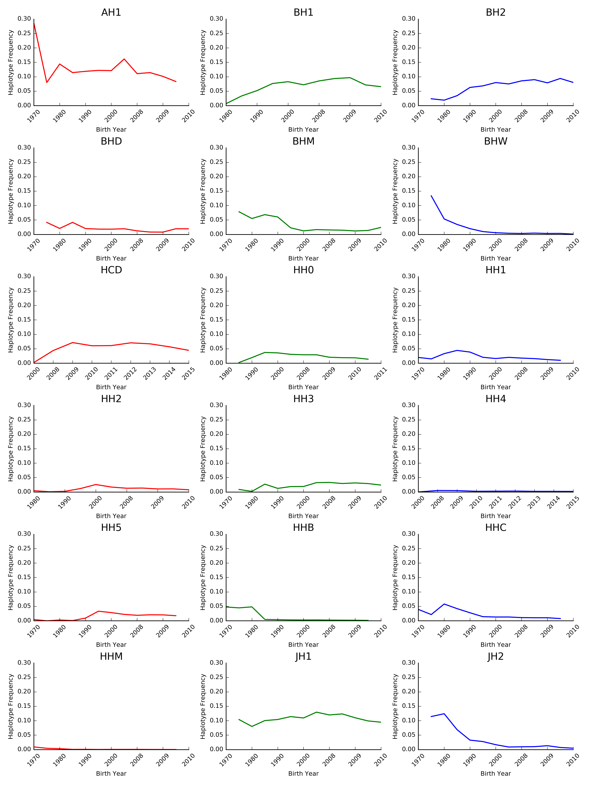
Frequencies change over time
The best way to reduce the frequency of harmful alleles is to not use carrier bulls!
Source: Cole et al. (2016).

Slide 19
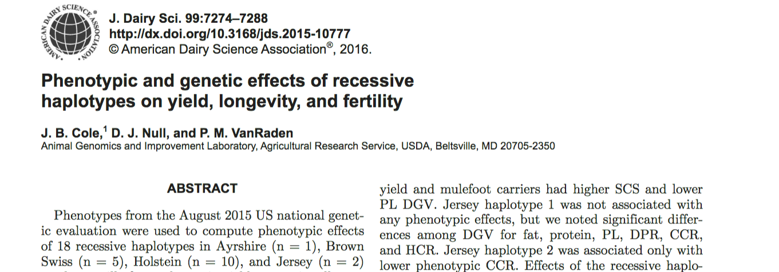
Do recessives affect other traits?
Effects of recessive haplotypes on yield, fertility, and longevity generally were small even when significant

Slide 20
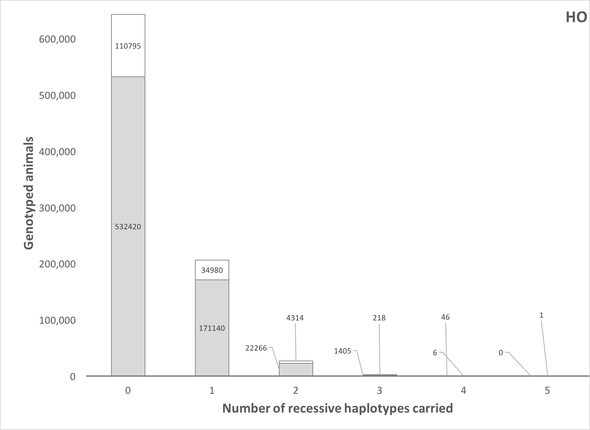
How many defects do animals carry?
Source: Cole et al. (2016).

Slide 21
Estimated cost of genetic load
Cole et al. (2016) estimated annual losses of at least $10.7 million due to known recessives.
Average losses were $5.77, $3.65, $0.94, and $2.96 in Ayrshire, Brown Swiss, Holstein, and Jersey, respectively.
This is the economic impact of genetic load as it affects fertility and perinatal mortality.
Actual losses are likely to be higher.

Slide 22
Strategies for management of genetic disorders

Slide 23
Mate selection
The goal of mate selection is to match one bull to one cow for breeding (e.g., Kinghorn, 1987)
1
2
3
3
Semen for AI
4
5
Portfolio (group) of bulls

Slide 24
Previous approaches
Linear programming
EBV, inbreeding, dominance
Genetic algorithms
Complex to understand
Sequential mate allocation
Restrictions often needed
Group mating
Does not consider merit of cows

Slide 25
Large versus small dairies
In the US, mate allocation commonly is affected by the size of the dairy
Small farms can provide individual attention to each cow in the herd
Many bulls bred to individual cows
Large farms cannot provide individual attention due to labor constraints
One bull bred to many cows

Slide 26
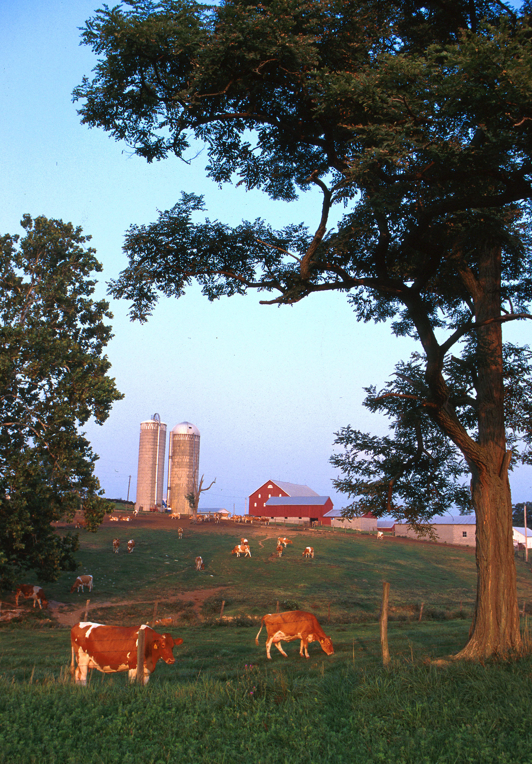
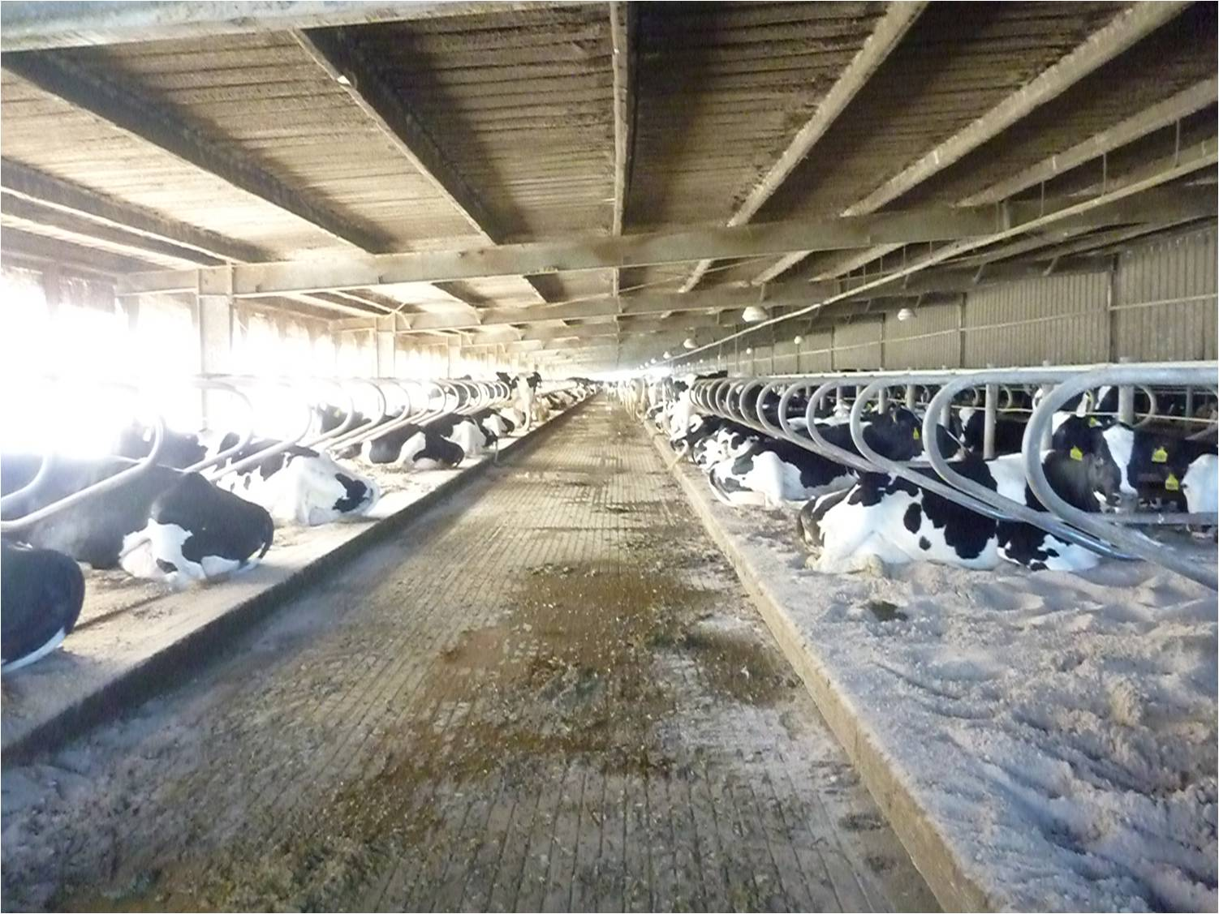
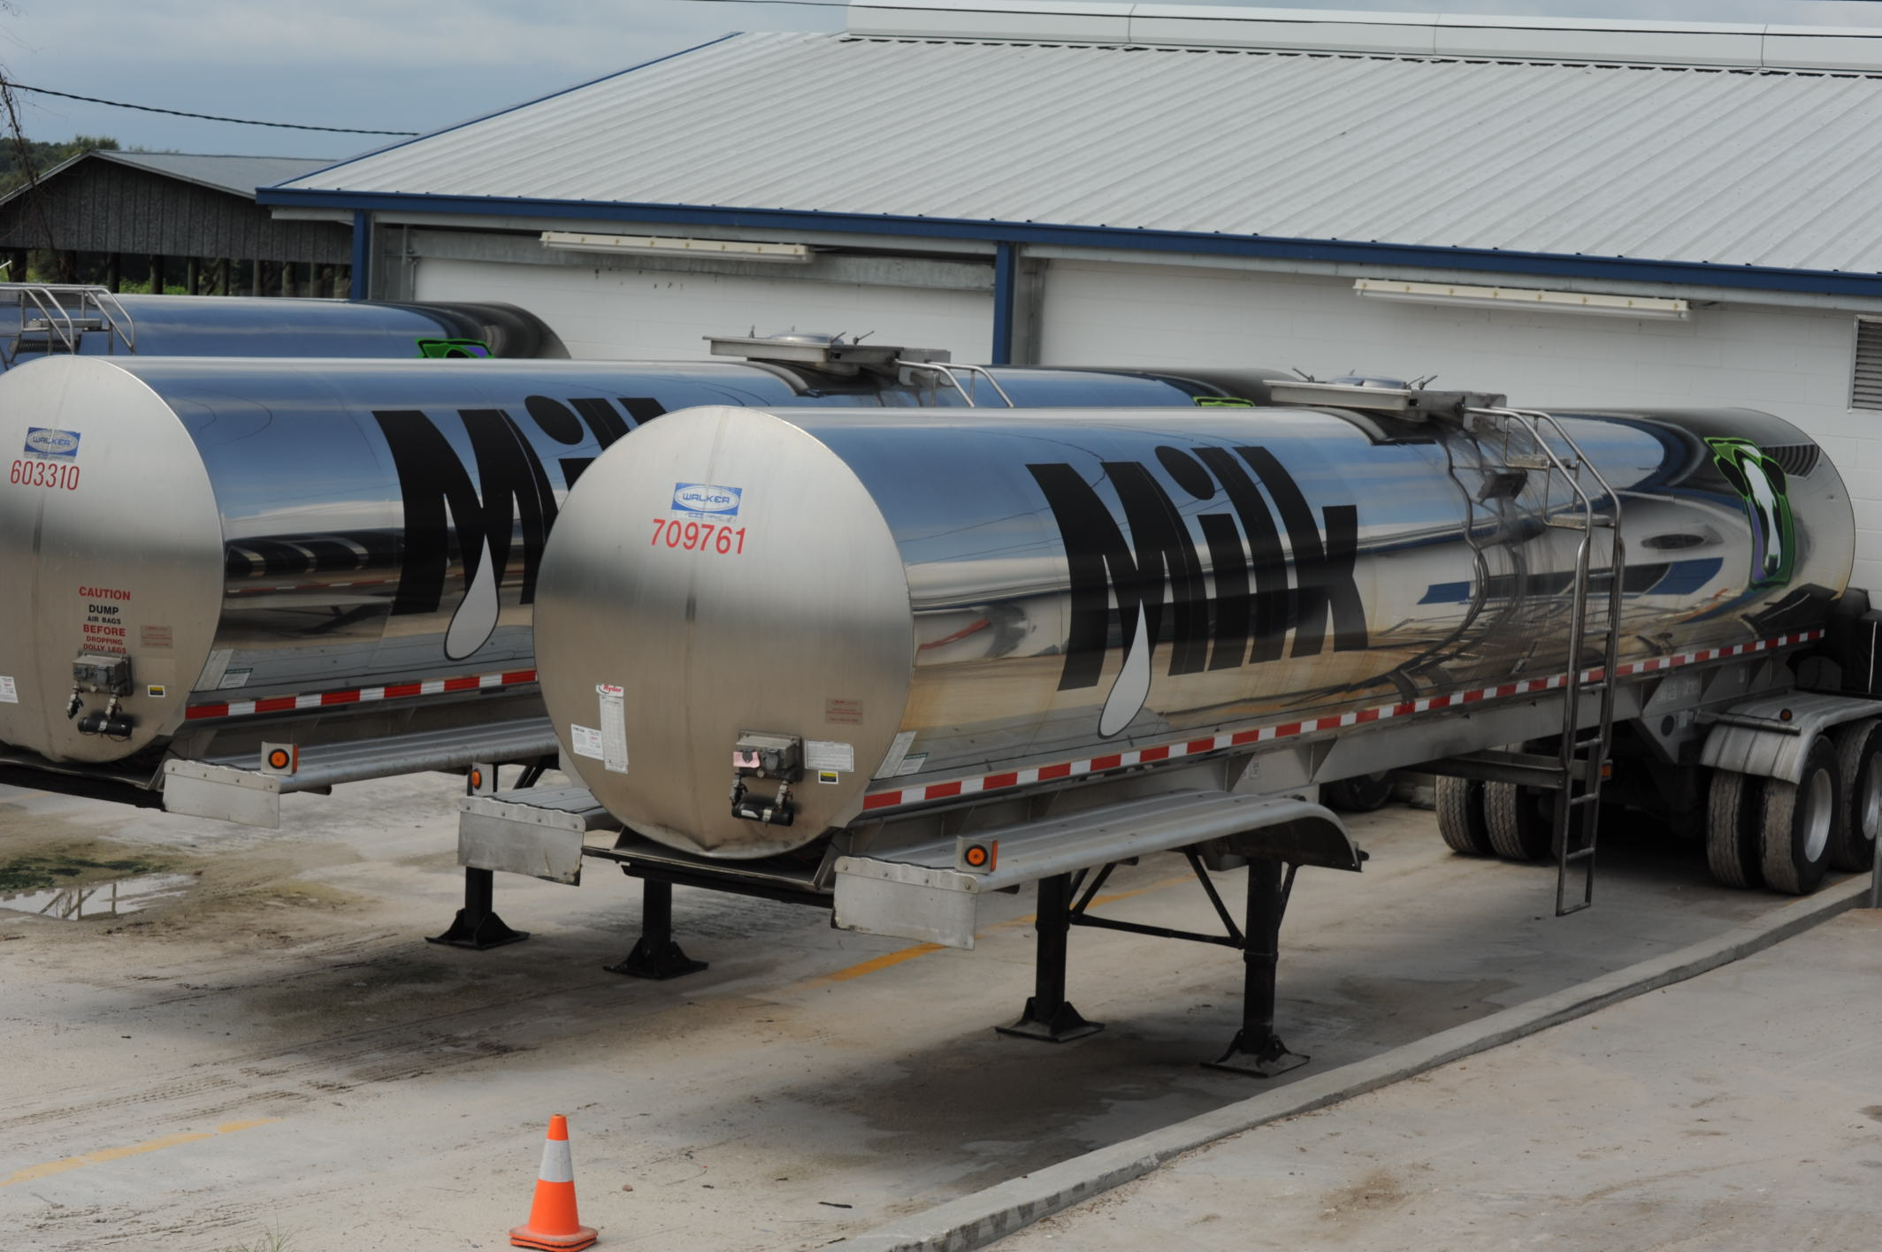
Typical US dairies
Top: Large freestall barn in the state of Florida.
Bottom: 7,000 G (~26,500 l) milk tankers.
Photo courtesy of North Florida Holsteins.
Small dairy farm in western Maryland. Photo courtesy of ARS.

Slide 27
Large herds using timed AI

Slide 28
Selection using marker information
Shepherd and Kinghorn (2001) described a look-ahead mate selection scheme using markers.
Li et al. (2006, 2008) showed QTL genotypes provide more benefit when used in mate selection.
Pryce et al. (2012) found that genotypes can be used to increase genetic gain while limiting inbreeding.
Van Eenennaam and Kinghorn (2014) proposed selection against the total number of lethal alleles and recessive lethal genotypes.
Cole (2015) suggested that parent averages can be adjusted to account for genetic load in sequential mate allocation schemes.

Slide 29
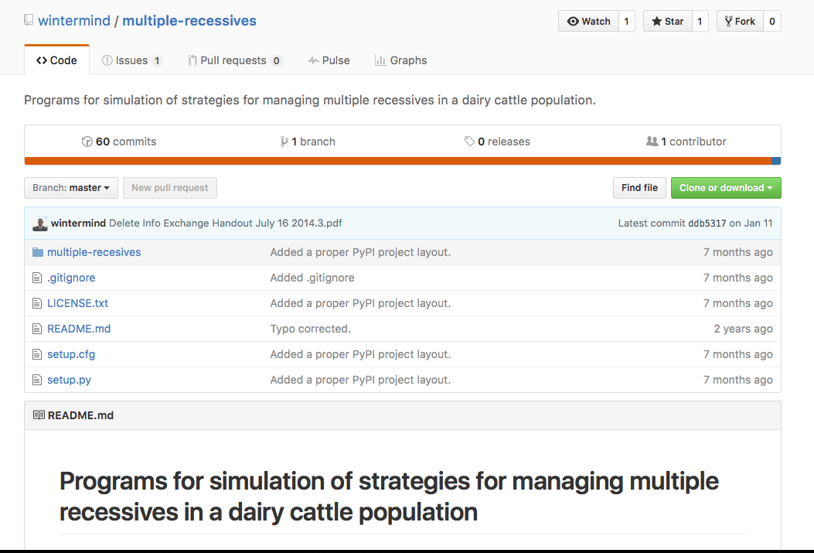
Computer simulation
A computer program was developed to study different mate allocation scenarios
https://github.com/wintermind/multiple-recessives
Any number or combination of recessives may be simulated
Written in Python 2.7 with Jupyter notebooks for analysis
Has been extended to include gene editing
https://github.com/wintermind/gene-editing

Slide 30
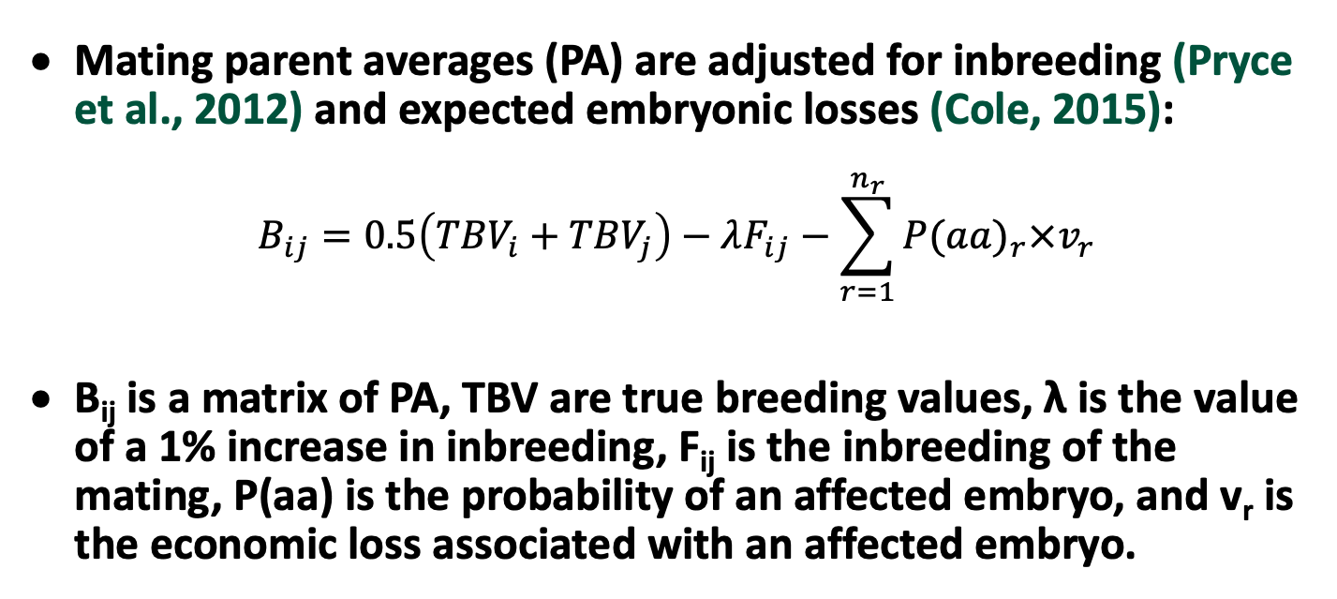
Sequential mate allocation
Mating parent averages (PA) are adjusted for inbreeding (Pryce et al., 2012) and expected embryonic losses (Cole, 2015):
$$B_{ij}=0.5\left({TBV}_{i}+{TBV}_{j}\right)−λF_{ij}−\sum_{r=1}^{n_{r}}{{P(aa)}_{r}×v_{r}}$$
B_{ij} is a matrix of PA, TBV are true breeding values, λ is the value of a 1% increase in inbreeding, F_{ij} is the inbreeding of the mating, P(aa) is the probability of an affected embryo, and v_{r} is the economic loss associated with an affected embryo.

Slide 31
Mate allocation (cont’d)
A matrix, M, is used to allocate bulls to cows
M_{ij} is set to 1 if B_{ij} is the greatest value in column j (largest PA available for mating to that cow)
If the sum of row i < the maximum number of permitted matings for that bull the mating is allocated
Otherwise, the bull with the next-highest value of B_{ij} is selected, and so on, until each column has one and only one element equal to 1

Slide 32
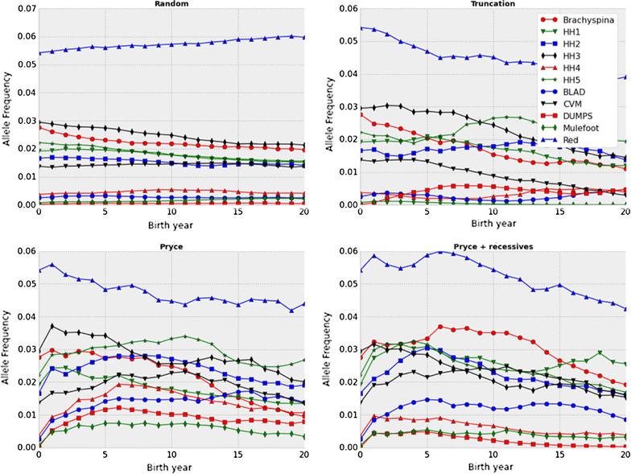
Frequencies change at different rates
Source: Cole (2015).

Slide 33
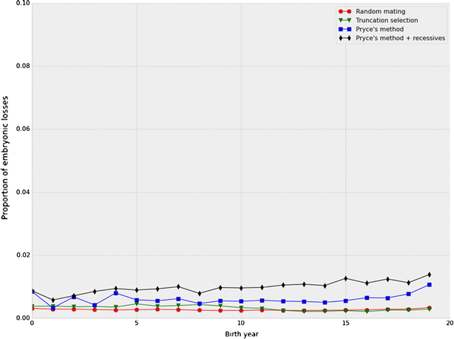
More embryos die when carriers used
Source: Cole (2015).

Slide 34
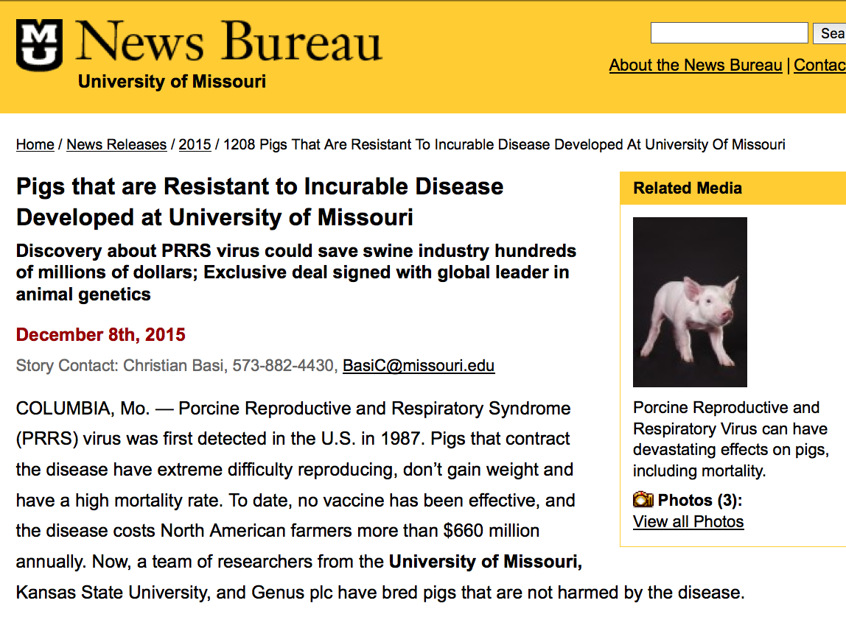
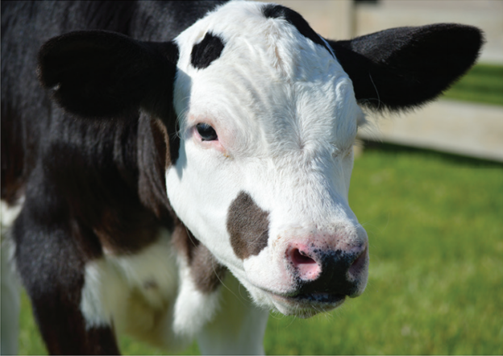
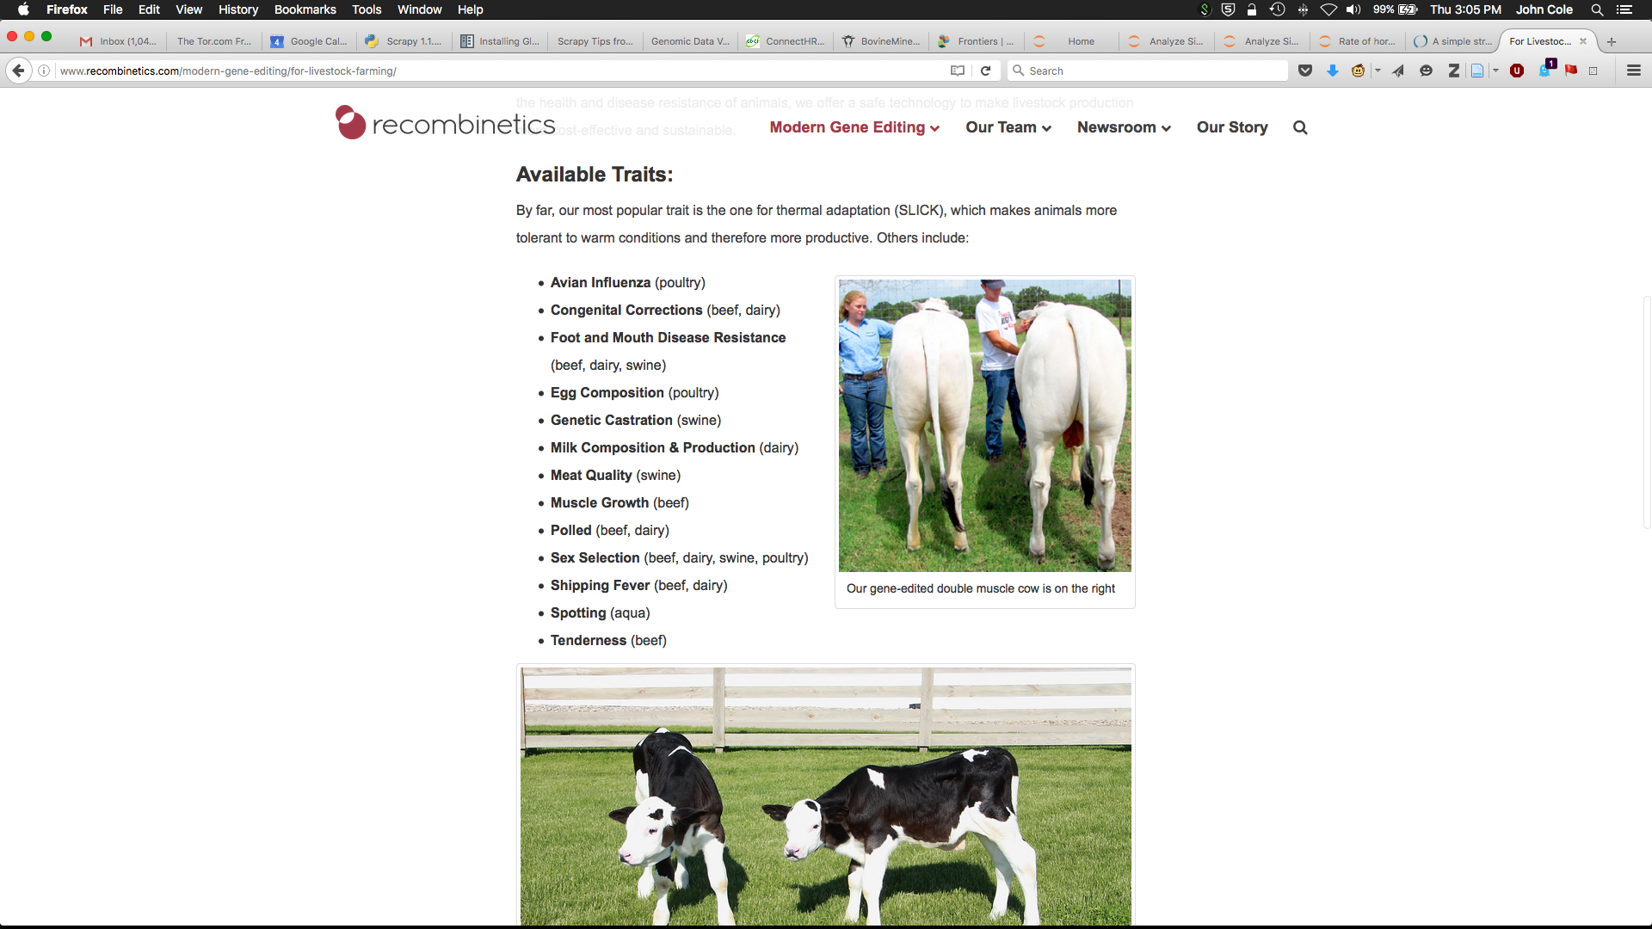
Gene editing in livestock

Slide 35
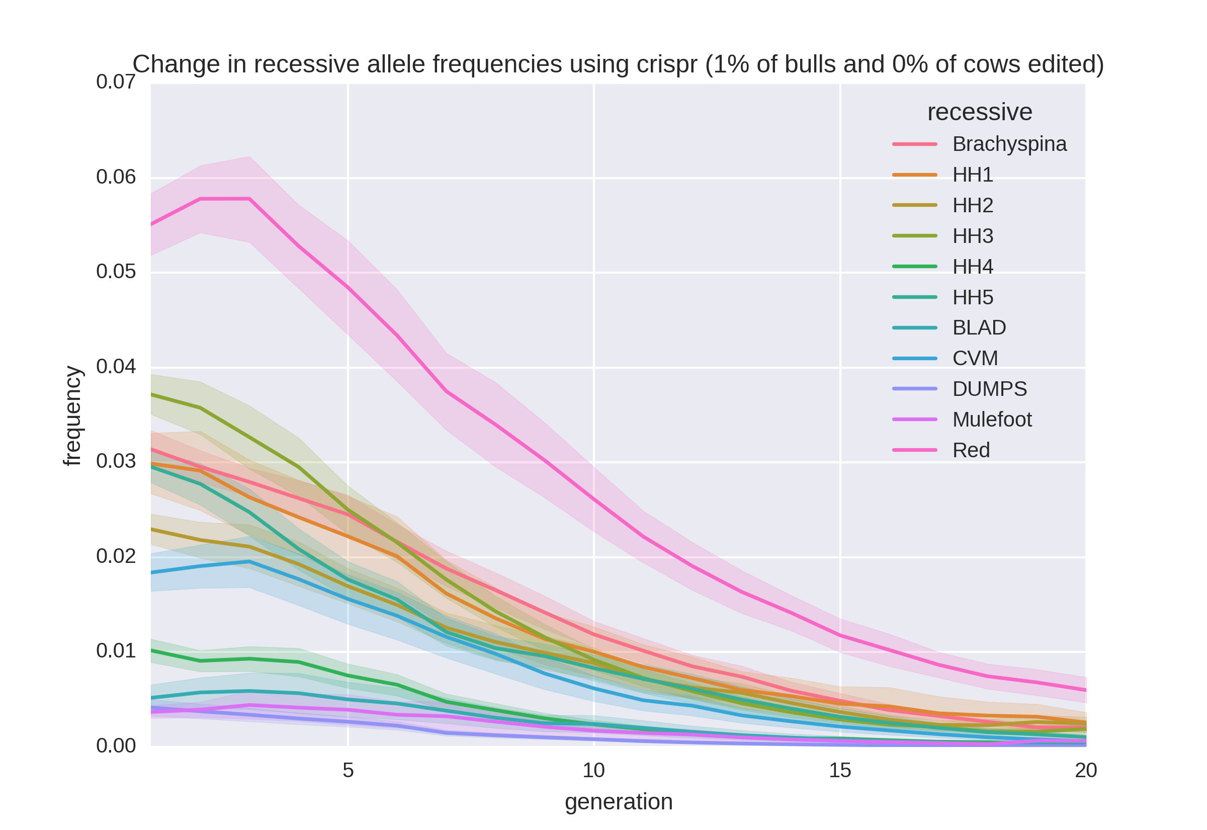
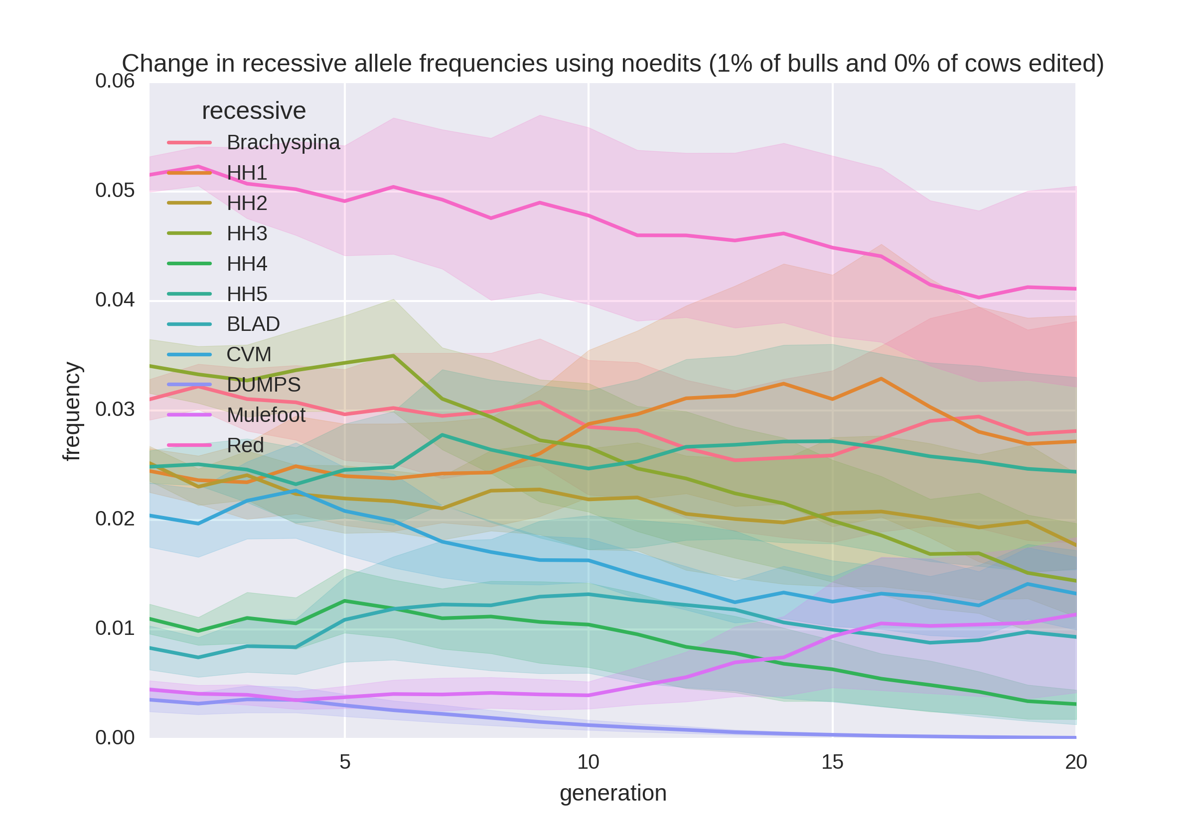
Allele frequency change
Progress is faster with editing than without

Slide 36
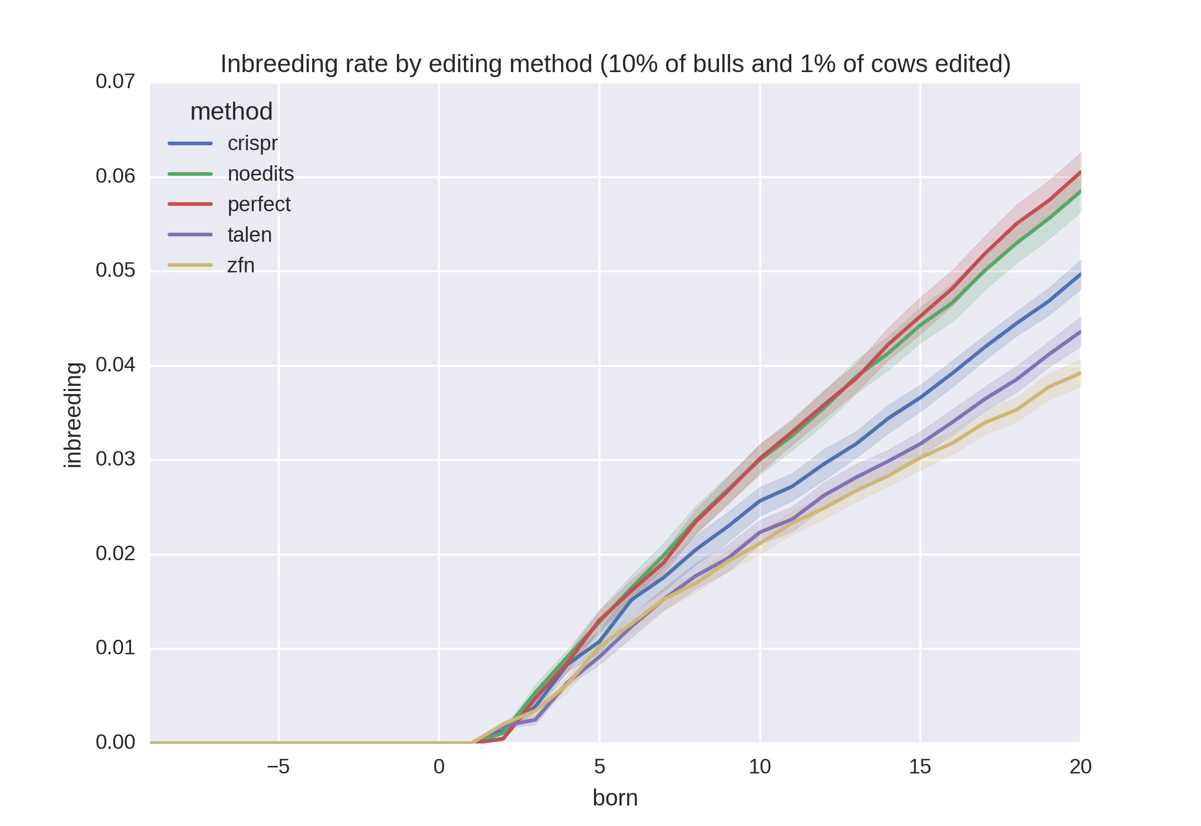
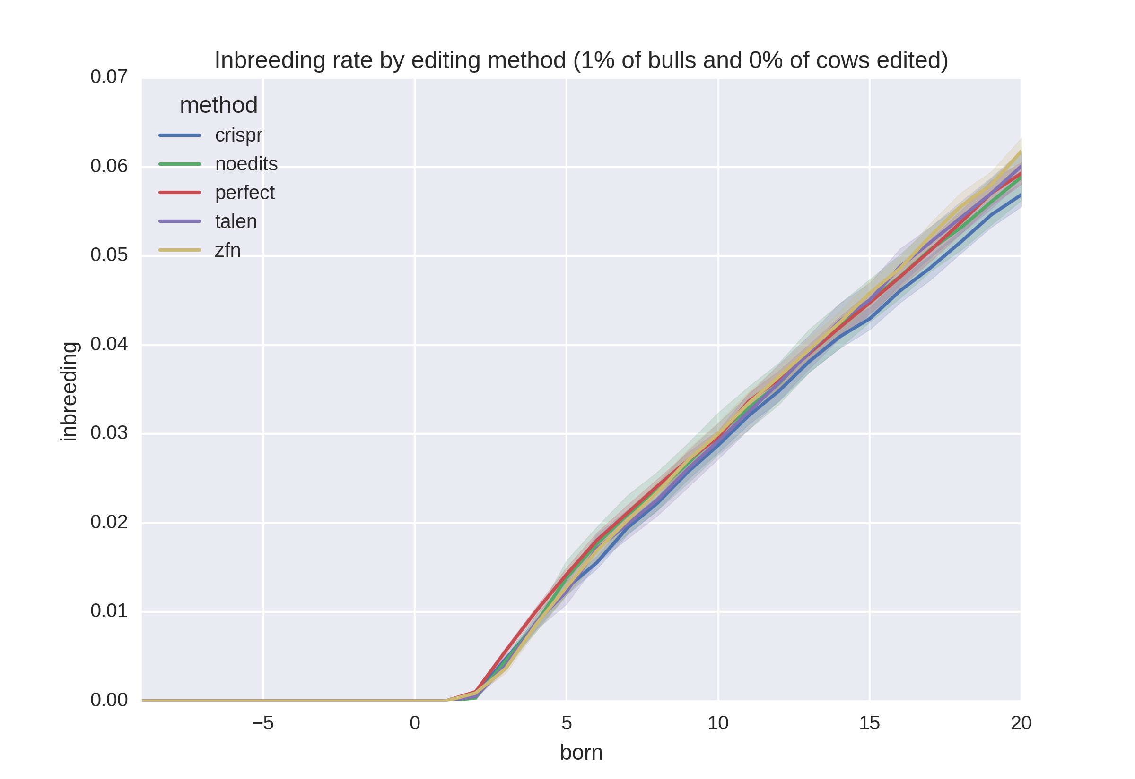
Rates of inbreeding
The way in which editing is used can affect population diversity.

Slide 37
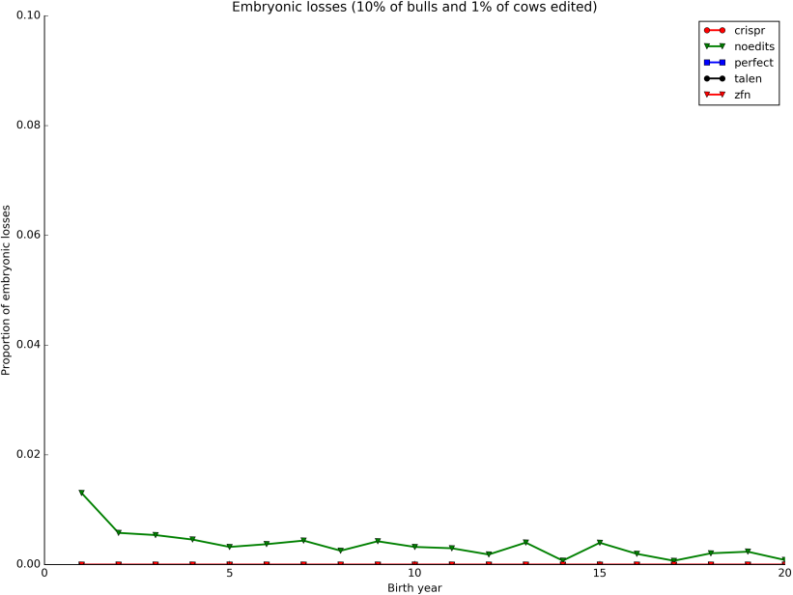
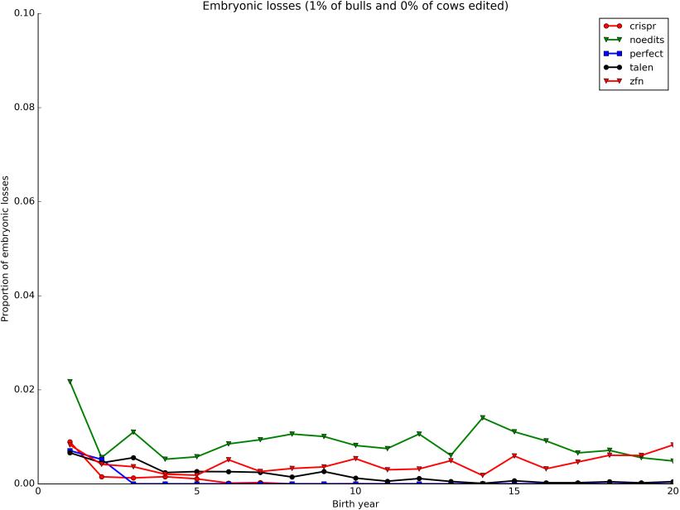
Embryonic deaths by generation
Source: Cole and Mueller (2018).
Sources: Top left, Cole (2015); Center and top right, Cole and Mueller (2018)

Slide 38
What is the best strategy for dealing with recessives?
Remove carrier bulls from the population
Non-carrier bulls are as good as carrier bulls
 | Carriers |  |  |  | Non-carriers
Breed | N | Mean | SD |  | N | Mean | SD | Difference | P value
AY | 16 | 286.43 | 194.67 |  | 53 | 272.41 | 191.69 | 13.02 | 0.407
BS | 30 | 223.10 | 218.39 |  | 59 | 284.19 | 160.36 | -61.09 | 0.087
HO | 550 | 394.08 | 216.77 |  | 1,765 | 479.49 | 213.89 | -85.41 | <0.001
JE | 99 | 340.51 | 149.00 |  | 378 | 338.82 | 153.99 | 1.69 | 0.460
Source: Cole et al. (2016).

Slide 39
Conclusions
Mendelian genetic disorders are responsible for economic losses to dairy farmers
As technology improves we are identifying more recessive defects
Gene editing should be used to eliminate harmful alleles from the population
Carrier bulls should not be used when non-carrier bulls are of comparable genetic merit

Slide 40
Disclaimer
The author was supported by USDA-ARS project 8042-31000-002-00-D, “Improving Dairy Animals by Increasing Accuracy of Genomic Prediction, Evaluating New Traits, and Redefining Selection Goals”.
USDA is an equal opportunity provider and employer.
Mention of trade names or commercial products in this presentation is solely for the purpose of providing specific information and does not imply recommendation or endorsement by the US Department of Agriculture.

Slide 41
Job opportunities at AGIL
AGIL has a permanent position available for an animal scientist. Applications for this announcement ARS-S18Y-0281 must be received by Nov 7: https://www.usajobs.gov/GetJob/ViewDetails/514277600.
A 1-year postdoc position through ORISE (reference code: ARS-AGIL-2018-127-0040-01) is available on the topic of unknown/uncertain parentage and the potential benefits from ancestor discovery, and is open to all applicants regardless of citizenship: https://zintellect.com/Opportunity/Details/ARS-AGIL-2018-127-0040-01.

Slide 42

Questions?

Slide 43
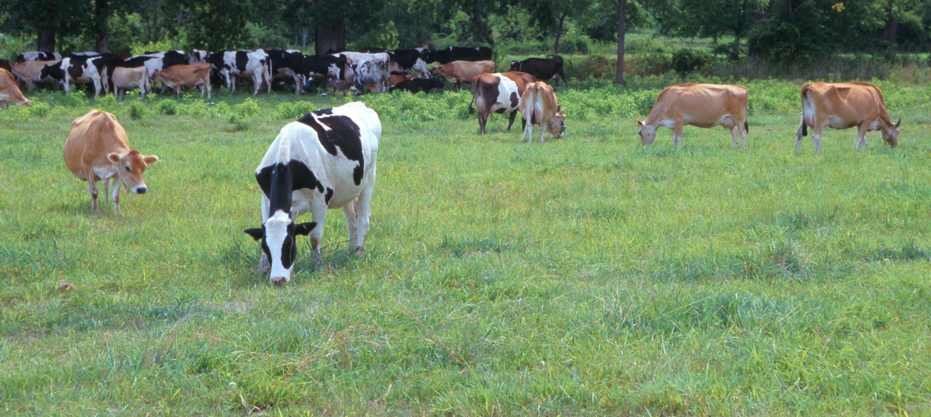
Questions?
AIP web site:
http://aipl.arsusda.gov/
Holstein and Jersey crossbreds graze on American Farm Land Trust’s
Cove Mountain Farm in south-central Pennsylvania
Source: ARS Image Gallery, image #K8587-14; photo by Bob Nichols

Slide 44
References
Adams, H.A., T.S. Sonstegard, P.M. VanRaden, D.J. Null, C.P. Van Tassell, D.M. Larkin, and H.A. Lewin. 2016. Identification of a nonsense mutation in APAF1 that is likely causal for a decrease in reproductive efficiency in Holstein dairy cattle. J. Dairy Sci. 99:6693-6701.
Agerholm, J.S., F. McEvoy, and J. Arnbjerg. 2006. Brachyspina syndrome in a Holstein calf. J. Vet. Diagn. Invest. 18:418–422.
Cole, J.B. 2015. A simple strategy for managing many recessive disorders in a dairy cattle breeding program. Genet. Sel. Evol. 47:94.
Cole, J.B., and M.L. Mueller. 2018. Management of Mendelian traits in breeding programs by gene editing: A simulation study. (In preparation.)
Cole, J.B., D.J. Null, and P.M. VanRaden. 2016. Phenotypic and genetic effects of recessive haplotypes on yield, longevity, and fertility. J. Dairy Sci. 99:7274-7288.

Slide 45
References (cont’d)
Duchesne, A., M. Gautier, S. Chadi, C. Grohs, S. Floriot, Y. Gallard, G. Caste, A. Ducos, and A. Eggen. 2006. Identification of a double missense substitution in the bovine LRP4 gene as a candidate causal mutation for syndactyly in Holstein cattle. Genomics 88:610–621.
Fritz, S., C. Hoze, E. Rebours, A. Barbat, M. Bizard, A. Chamberlain, C. Escouflaire, C. Vander Jagt, M. Boussaha, C. Grohs, A. Allais-Bonnet, M. Philippe, A. Vallée, Y. Amigues, B.J. Hayes, D. Boichard, and A. Capitan. 2018. An initiator codon mutation in SDE2 causes recessive embryonic lethality in Holstein cattle. J. Dairy Sci. 101:6220-6231
Gaj, T., C.A. Gersbach, and C.F. Barbas III. 2013. ZFN, TALEN, and CRISPR/Cas-based methods for genome engineering. Trends Biotechnol. 31:398–405.
Kinghorn, B. 1987. On computing strategies for mate allocation. J. Anim. Breed. Genet. 104:12-22.
Li, Y., J.H.J. van der Werf, and B.P. Kinghorn. 2006. Optimisation of crossing system using mate selection. Genet. Sel. Evol. 38:147–65.

Slide 46
References (cont’d)
Li, Y., J.H.J. van der Werf, and B.P. Kinghorn. 2008. Optimal utilization of non-additive quantitative trait locus in animal breeding programs. J. Anim. Breed. Genet. 125:342–50.
MacArthur, D.G., S. Balasubramanian, A. Frankish, N. Huang N, J. Morris, et al. 2012. A systematic survey of loss-of-function polymorphisms in human protein-coding genes. Science 335:823–828.
Müller, M., J. Berger, N. Gersdorff, F. Cecconi, R. Herken, and F. Quondamatteo. 2005. Localization of Apaf1 gene expression in the early development of the mouse by means of in situ reverse transcriptase‐polymerase chain reaction. Devel. Dynam. 234:215-221.
Müller, M., J. Berger, N. Gersdorff, F. Cecconi, R. Herken, and F. Quondamatteo. 2005. Localization of Apaf1 gene expression in the early development of the mouse by means of in situ reverse transcriptase‐polymerase chain reaction. Devel. Dynam. 234:215-221.
Pryce, J.E., B.J. Hayes, and M.E. Goddard. 2012. Novel strategies to minimize progeny inbreeding while maximizing genetic gain using genomic information. J. Dairy Sci. 95:377–388.

Slide 47
References (cont’d)
Shepherd, R.K., and B.P. Kinghorn. 2001. Designing algorithms for mate selection when major genes or QTL are important. Proc. Assoc. Advmt. Anim. Breed. Genet. 14:377–80.
Taylor, J.F., R.D. Schnabel, B. Simpson, J.E. Decker, M. Rolf, B.P. Kinghorn, A. Van Eenennaam, M.D. MacNeil, D.S. Brown, M.F. Smith, and D.J. Patterson. 2016. Detection and selection against early embryonic lethals in United States beef breeds. J. Animal Sci. 94(Suppl. 5):331(Abstr.).
Van Eenennaam A.L., and B.P. Kinghorn. 2014. Use of mate selection software to manage lethal recessive conditions in livestock populations. In: Proceedings of the 10th WCGALP: 17–22 August 2014; Vancouver.
Widmar, N.J.O., M.M. Schutz, and J.B. Cole. 2013. Breeding for polled dairy cows versus dehorning: Preliminary cost assessments & discussion. J.Dairy Sci. 96(Suppl. 2):602 (abstr. TH373).

