Slide 1
The science of feeding 9 billion people
John B. Cole
Quantitative Genetics and Genomics
LSMSA c/o 1990
LSU c/o 1994, 1996, 2003
john.b.cole@gmail.com

Slide 2

Well, here we are…

Slide 3
Outline
Agricultural research and the challenge of feeding 9 billion people
Dairy data and genetic improvement
Using genomic information to find causal variants
Questions and (maybe) answers
Source: https://xkcd.com/585/.

Slide 4
No-bull guarantee!

Slide 5
It was inevitable that I become a scientist
Source: https://xkcd.com/242/.

Slide 6
Me, at work

Slide 7
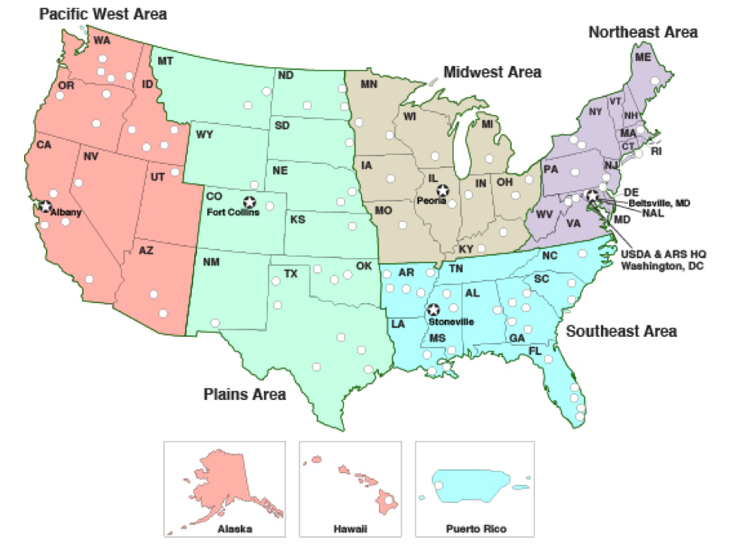
Where are ARS researchers located?

Slide 8
Animal Genomics and Improvement Lab
AGIL discovers and develops improved methods for the genetic and genomic evaluation of economically important traits of dairy animals and small ruminants and conducts fundamental genomics-based research aimed at improving their health and productive efficiency.
There are 3 projects, 11 PhD scientists, and 18.6 support personnel under the AGIL umbrella.

Slide 9
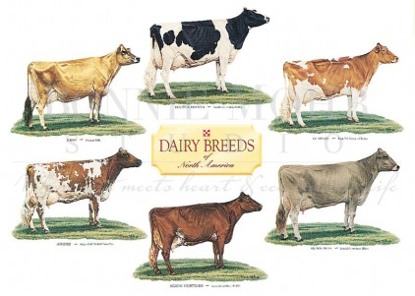
Traditional dairy breeds in the US
The six traditional US dairy breeds. Photo courtesy of Bonnie Mohr.

Slide 10
What is the value of genetic selection?
In 2015: 1957 base was 44% of total fat,
management was 28% of gains, and
genetics was 28% of gains

Slide 11
It’s not just livestock, either!
Source: University of Nebraska-Lincoln (http://passel.unl.edu/pages/informationmodule.php?idinformationmodule=1075412493&topicorder=10&maxto=12)

Slide 12
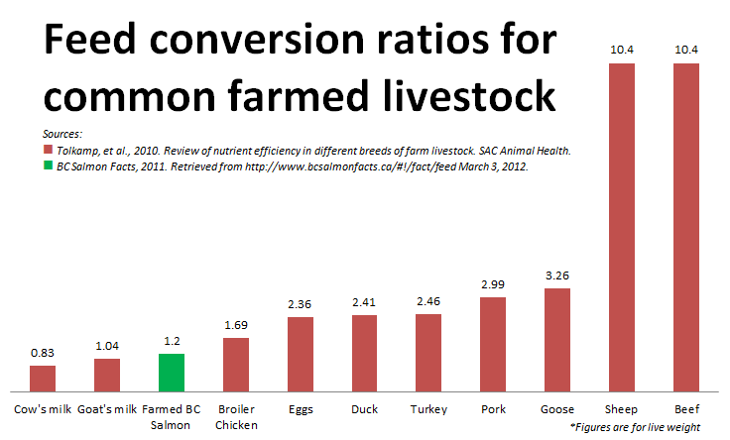
Dairy is an efficient use of resources
Source: https://johnkutensky.wordpress.com/2014/08/28/eating-on-other-planets/.

Slide 13
U.S. DHI dairy statistics (2011)
9.1 million U.S. cows
~75% bred AI
47% milk recorded through Dairy Herd Information (DHI)
4.4 million cows
86% Holstein
8% crossbred
5% Jersey
<1% Ayrshire, Brown Swiss, Guernsey, Milking Shorthorn, Red & White
20,000 herds
220 cows/herd
10,300 kg/cow

Slide 14
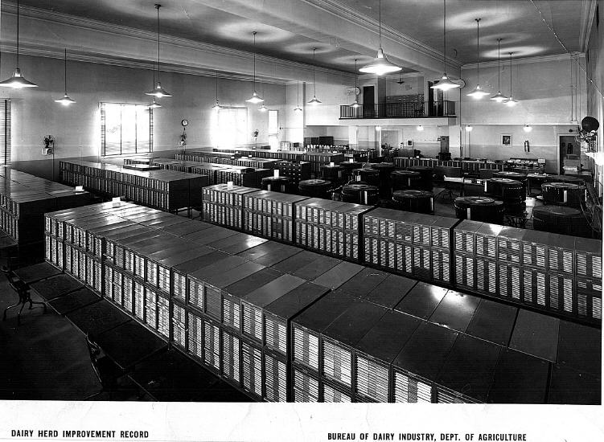
DHI Records Database, 1935

Slide 15
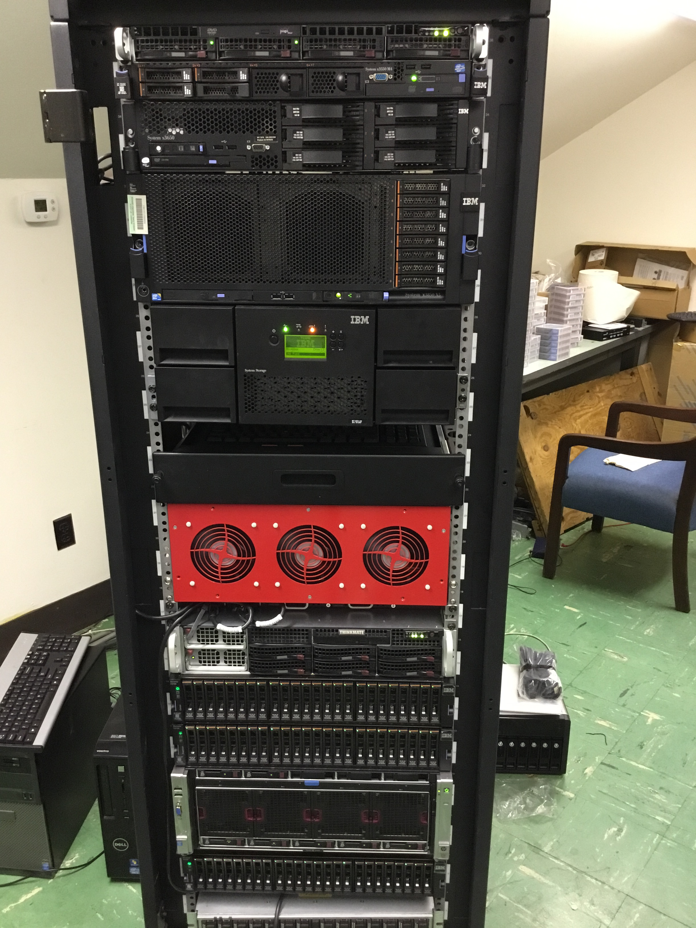
DHI Records Database, 2016

Slide 16
LSMSA computing, ca. 1989

Slide 17
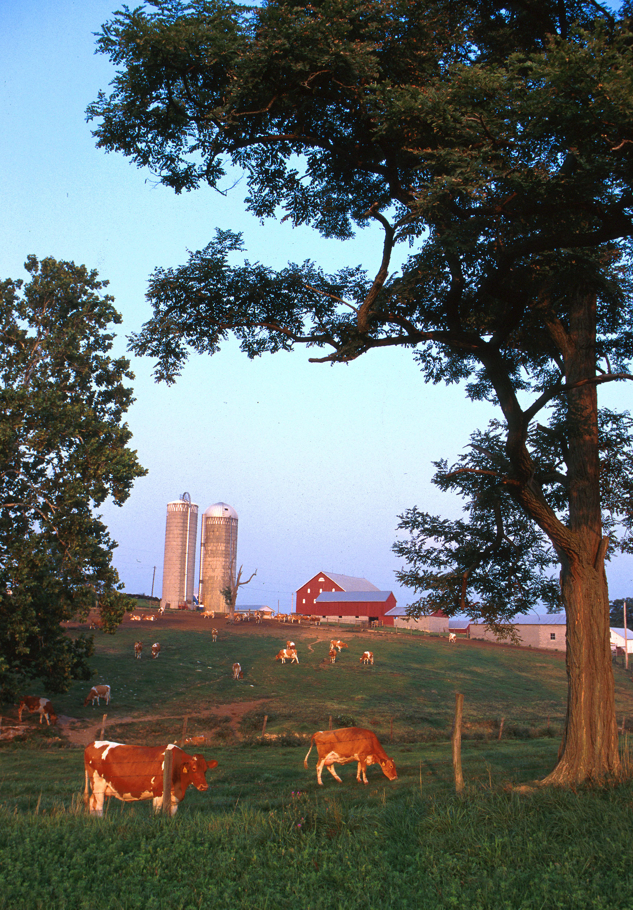
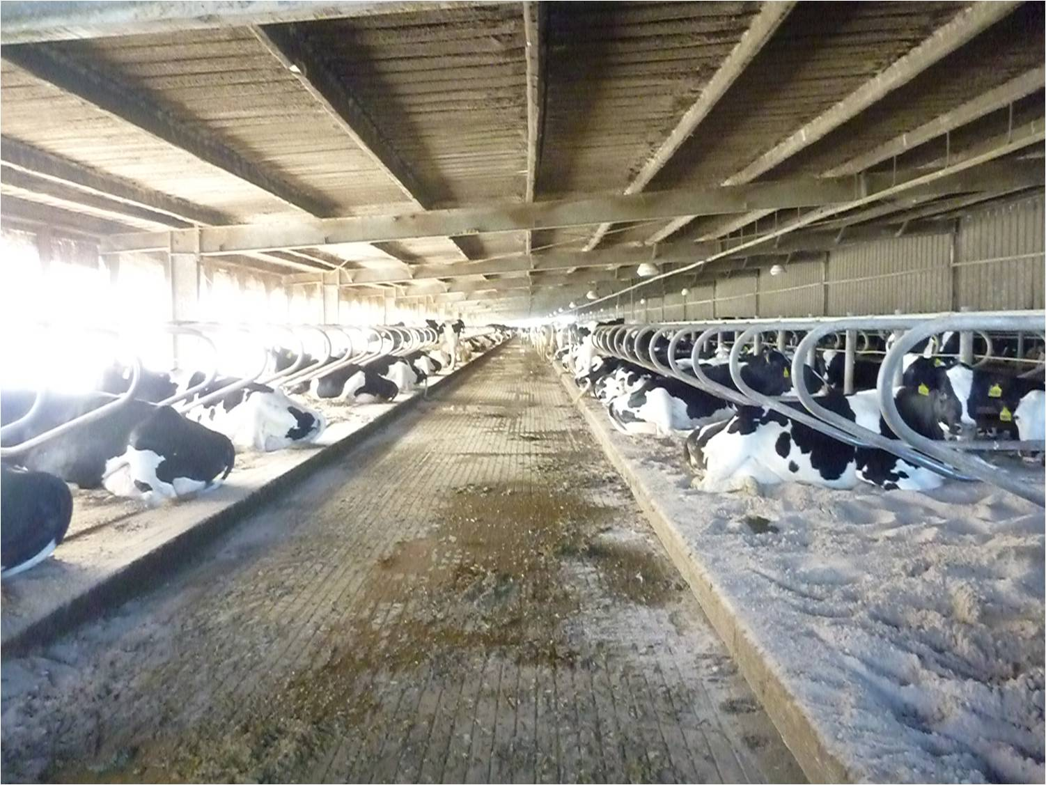
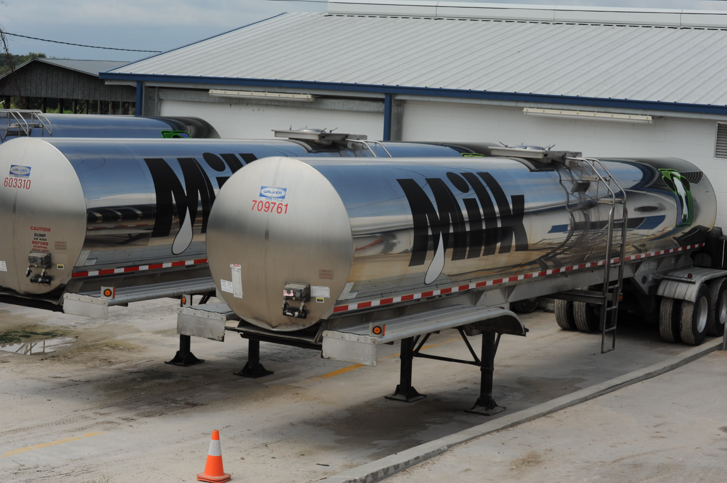
Typical US dairies
Small dairy farm in western Maryland. Photo courtesy of ARS.
Top: Large freestall barn in the state of Florida.
Bottom: 7,000 G (~26,500 l) milk tankers.
Photo courtesy of North Florida Holsteins.

Slide 18
How does genetic selection work?

Slide 19
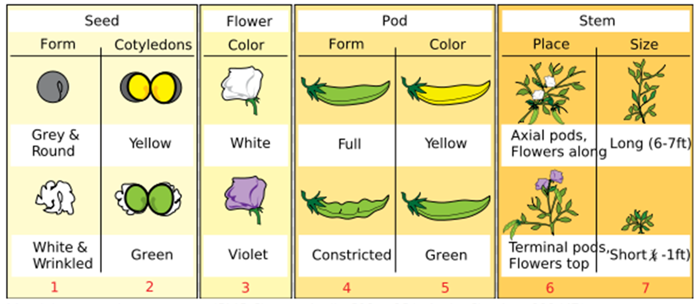
Modern genetics based on Mendel
Source: https://adapaproject.org/bbk_temp/tiki-index.php?page=Leaf%3A+Who+was+Gregor+Mendel%3F.

Slide 20
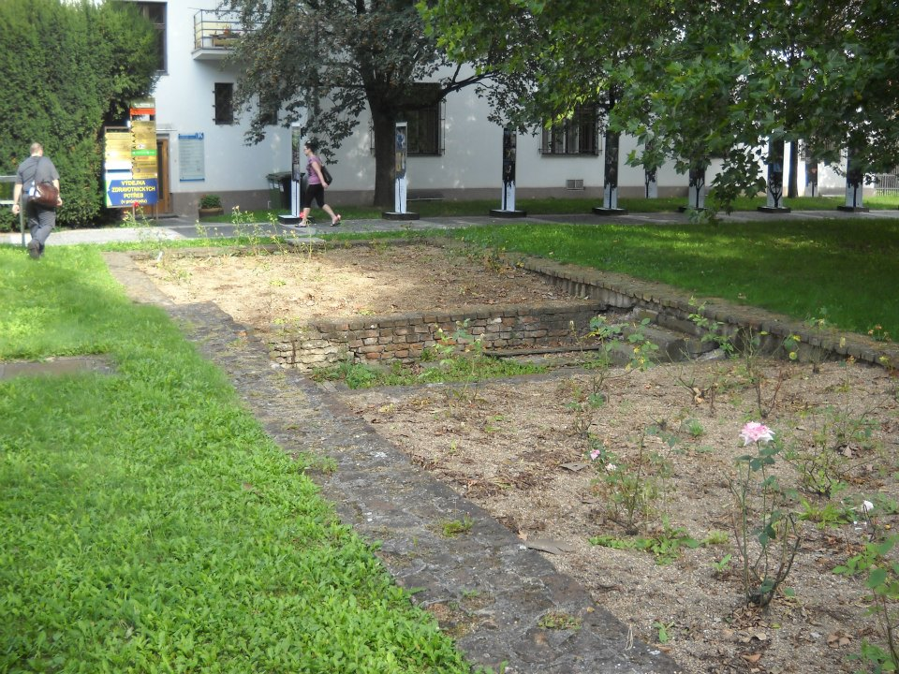

Slide 21

How does genetic selection work?
ΔG = genetic gain each year
reliability = how certain we are about our estimate of an animal’s genetic merit (genomics ⬆)
selection intensity = how selective we are when making mating decisions (management can ⬆)
genetic variance = variation in the population due to genetics (we can’t really change this)
generation interval = time between generations (genomics ⬇)

Slide 22
Some traits evaluated in the US
Year | Trait | Year | Trait
1926 | Milk & fat yields | 2006 | Stillbirth rate
1978 | Conformation (type) | 2006 | Bull conception rate²
1978 | Protein yield | 2009 | Cow & heifer conception rates
1994 | Productive life | 2016 | Cow livability
1994 | SCS (udder health) | 2017 | Cow health (research)³
2000 | Calving ease (dystocia)¹ | 2017 | Residual feed intake (research)³
2003 | Daughter pregnancy rate | 2017 | Gestation length (research)³
¹Sire calving ease evaluated by Iowa State University (1978–99)
²Estimated relative conception rate evaluated by DRMS in Raleigh, NC (1986–2005)
³Research trait … no official evaluations yet

Slide 23
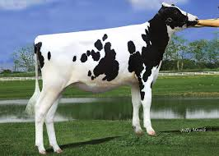
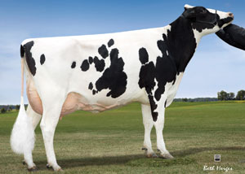
Genomic prediction
Main idea: improve future traits by selection
Look at animal’s own measurable traits (used for hundreds or thousands of years)
Use pedigrees and phenotypes to compute estimates of genetic merit (done officially by USDA 1937–2008)
2008 idea: Why not look directly at the DNA?

Slide 24
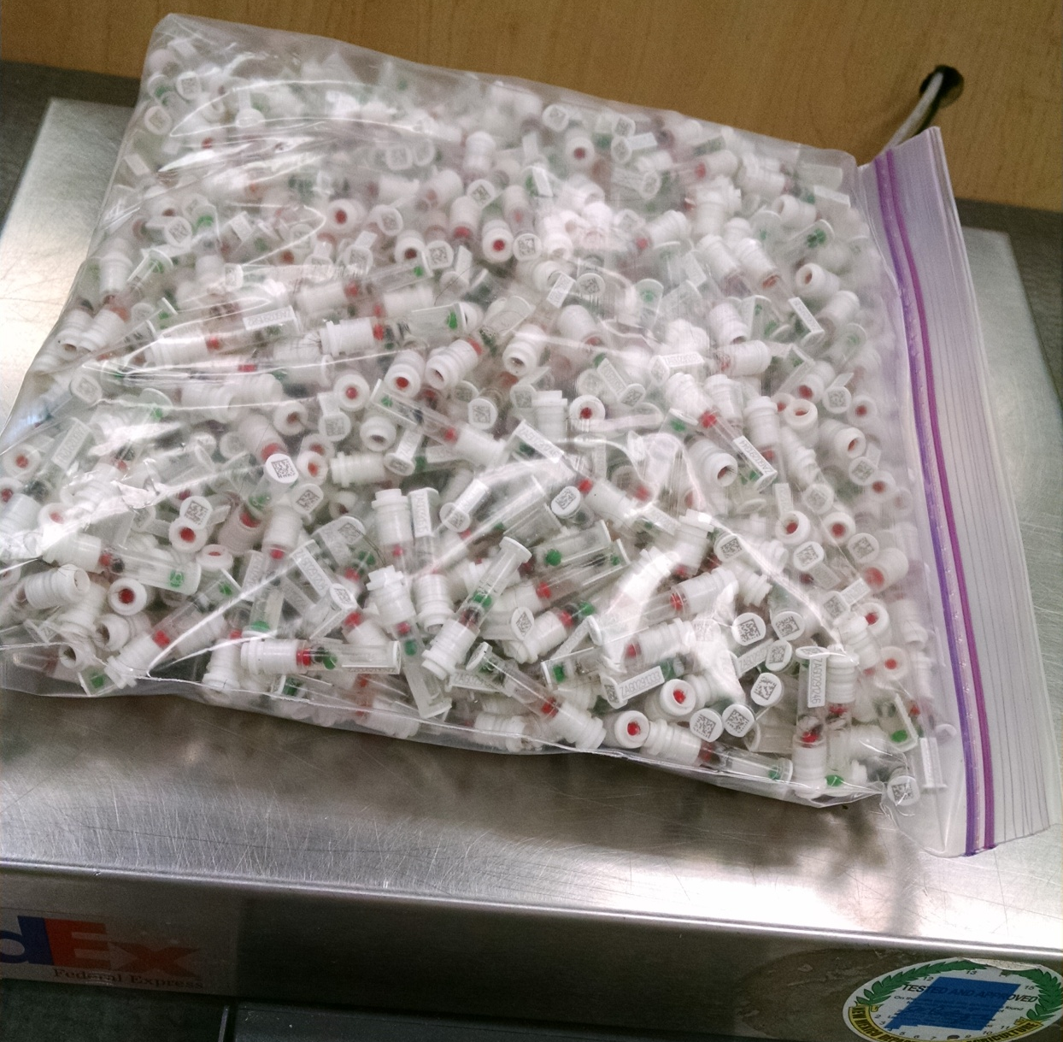
DNA samples from 1 farm, 1 day
Photo provided
by Zoetis

Slide 25
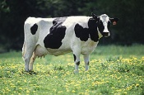
What’s a single SNP genotype worth?
Pedigree is equivalent to information on ~7 daughters
For protein yield (h²=0.30), the SNP genotype provides information equivalent to an additional ~32 daughters
Notes:
25

Slide 26
Genotype Contributors
by continent
Notes:
26

Slide 27
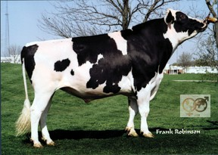
Progeny-tested bulls
O-Bee Manfred Justice
More than 100,000 daughters with milk yield records
60,000 in U.S. plus 40,000 in 25 other countries
1 million units of semen sold worth $30 million
About 10,000 dairy bulls/year were progeny tested
Best 10–20% selected for global use
Young bulls with genomic tests replacing progeny-tested bulls

Slide 28
Definitions are important!
Source: http://cowbirdsinlove.com/46.

Slide 29
Hunting genes

Slide 30
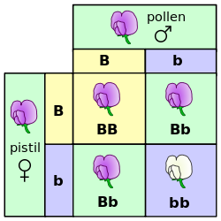
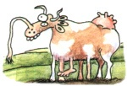
Mendelian recessives
Classical model of inheritance
One locus, typically with two alleles
Often exhibit complete dominance
e.g., Mendel’s experiments
Source: https://commons.wikimedia.org/wiki/File:Punnett_square_mendel_flowers.svg.

Slide 31
Mendelian recessives are not unusual
Name | Chrome | Location (Mbp) | Freq of minor haplotype |  | Gene Name
HH1 | 5 | 63.15 | 1.92 |  | APAF1
HH2 | 1 | 94.8 to 96.6 | 1.66 |  | unknown
HH3 | 8 | 95.41 | 2.95 |  | SMC2
HH4 | 1 | 1.27 | 0.37 |  | GART
HH5 | 9 | 93.2 to 93.3 | 2.22 |  | TFB1M
JH1 | 15 | 15.70 | 12.10 |  | CWC15
JH2 | 26 | 8.81 to 9.41 | 1.3 |  | unknown
BH1 | 7 | 42.8 to 47.0 | 6.67 |  | unknown
BH2 | 19 | 11.1 | 7.78 |  | TUBD1
AH1 | 17 | 65.92 | 13.0 |  | UBE3B
For a complete list, see: http://aipl.arsusda.gov/reference/recessive_haplotypes_ARR-G3.html.

Slide 32


Transmission of HH1 (APAF1)
100% free of recessives | 50% free, 50% carriers
50% free, 50% carriers | 25% free, 50% carriers, 25% die
Source: http://vet.tufts.edu/tas/images/002.png.

Slide 33
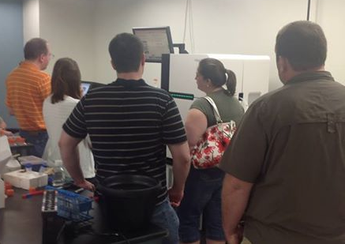
How many scientists does it take…

Slide 34
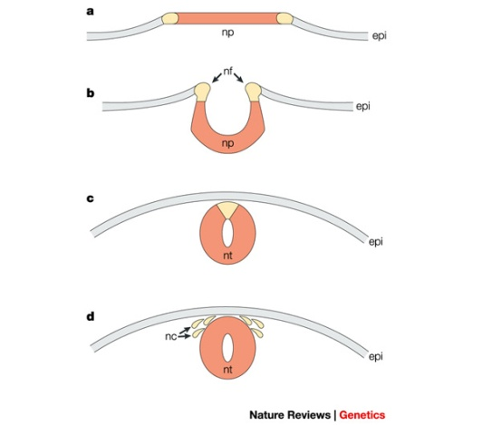
APAF1 (HH1)
Bos taurus apoptotic peptidase activating factor 1 (APAF1; Adams et al., 2016)
Gene expression for APAF1 in murine development begins between 7 and 9 d (Müller et al., 2005)
Gene knockout of APAF1 results in embryonic death
Proteins required for this pathway/cascade are important for neural tube closure in vivo

Slide 35
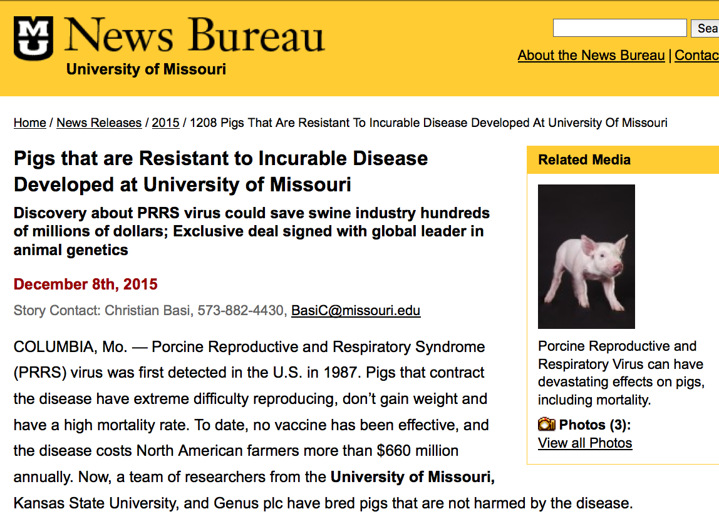
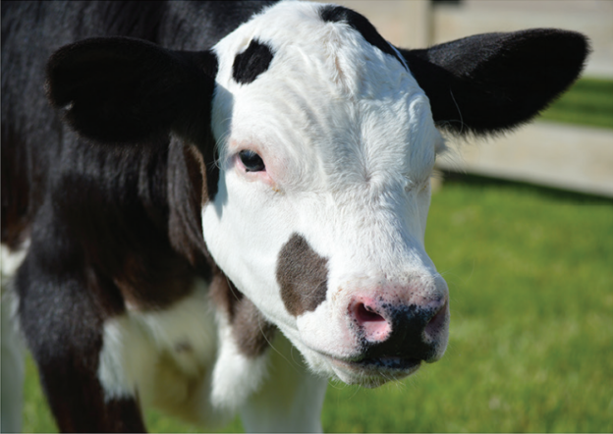
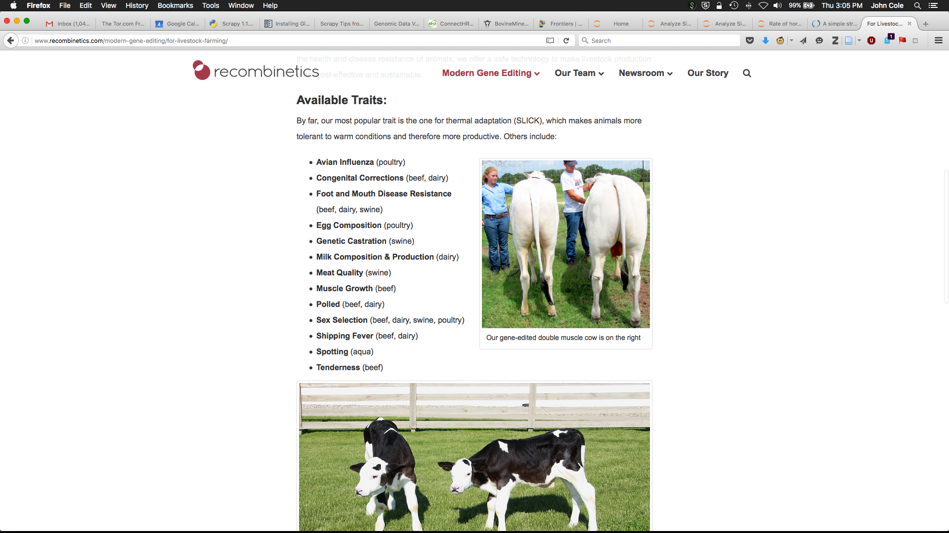
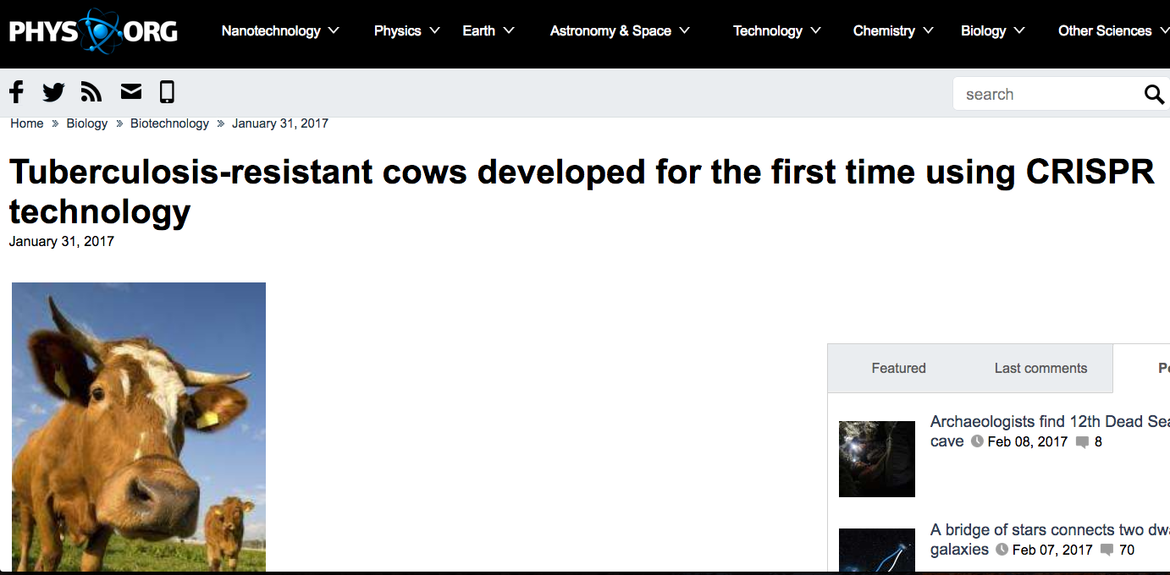
Other possibilities…

Slide 36
Some photos

Slide 37
Jerseys, near Bagé

Slide 38
Holsteins, near Berlin

Slide 39
Nelore, near Araçatuba

Slide 40
Have a hobby

Slide 41
It’s a tough life

Slide 42
Preparing for a career
Learn to write
Learn to speak in public
Be dependable
Learn another language
Cultivate other interests
Remember that science is about “how”, not necessarily “why”

Slide 43
Use your knowledge wisely!
Source: https://umarket.utah.edu/um2/humanities/product.php?product=7.

Slide 44

Questions?

