Slide 1
Opportunities and challenges from deep-phenotyping of dairy cattle
John B. Cole,^{1,*} Sophie A.E. Eaglen,² Christian Maltecca,³ Han A. Mulder,⁴ and Jennie E. Pryce⁵
¹Animal Genomics and Improvement Laboratory, ARS, USDA
²National Association of Animal Breeders
³Department of Animal Science, NCSU
⁴Department of Animal Sciences, Wageningen University & Research
⁵Agriculture Victoria Research & La Trobe University

Slide 2
Introduction
Genetic selection has been very successful
Continued genetic success requires deep-phenotyping and optimal environments
We must increase outputs for unit of input, and reduce undesirable by-products
Improved animal efficiency may be in conflict with improved health and resilience of animals
As always, technology presents challenges and opportunities

Slide 3
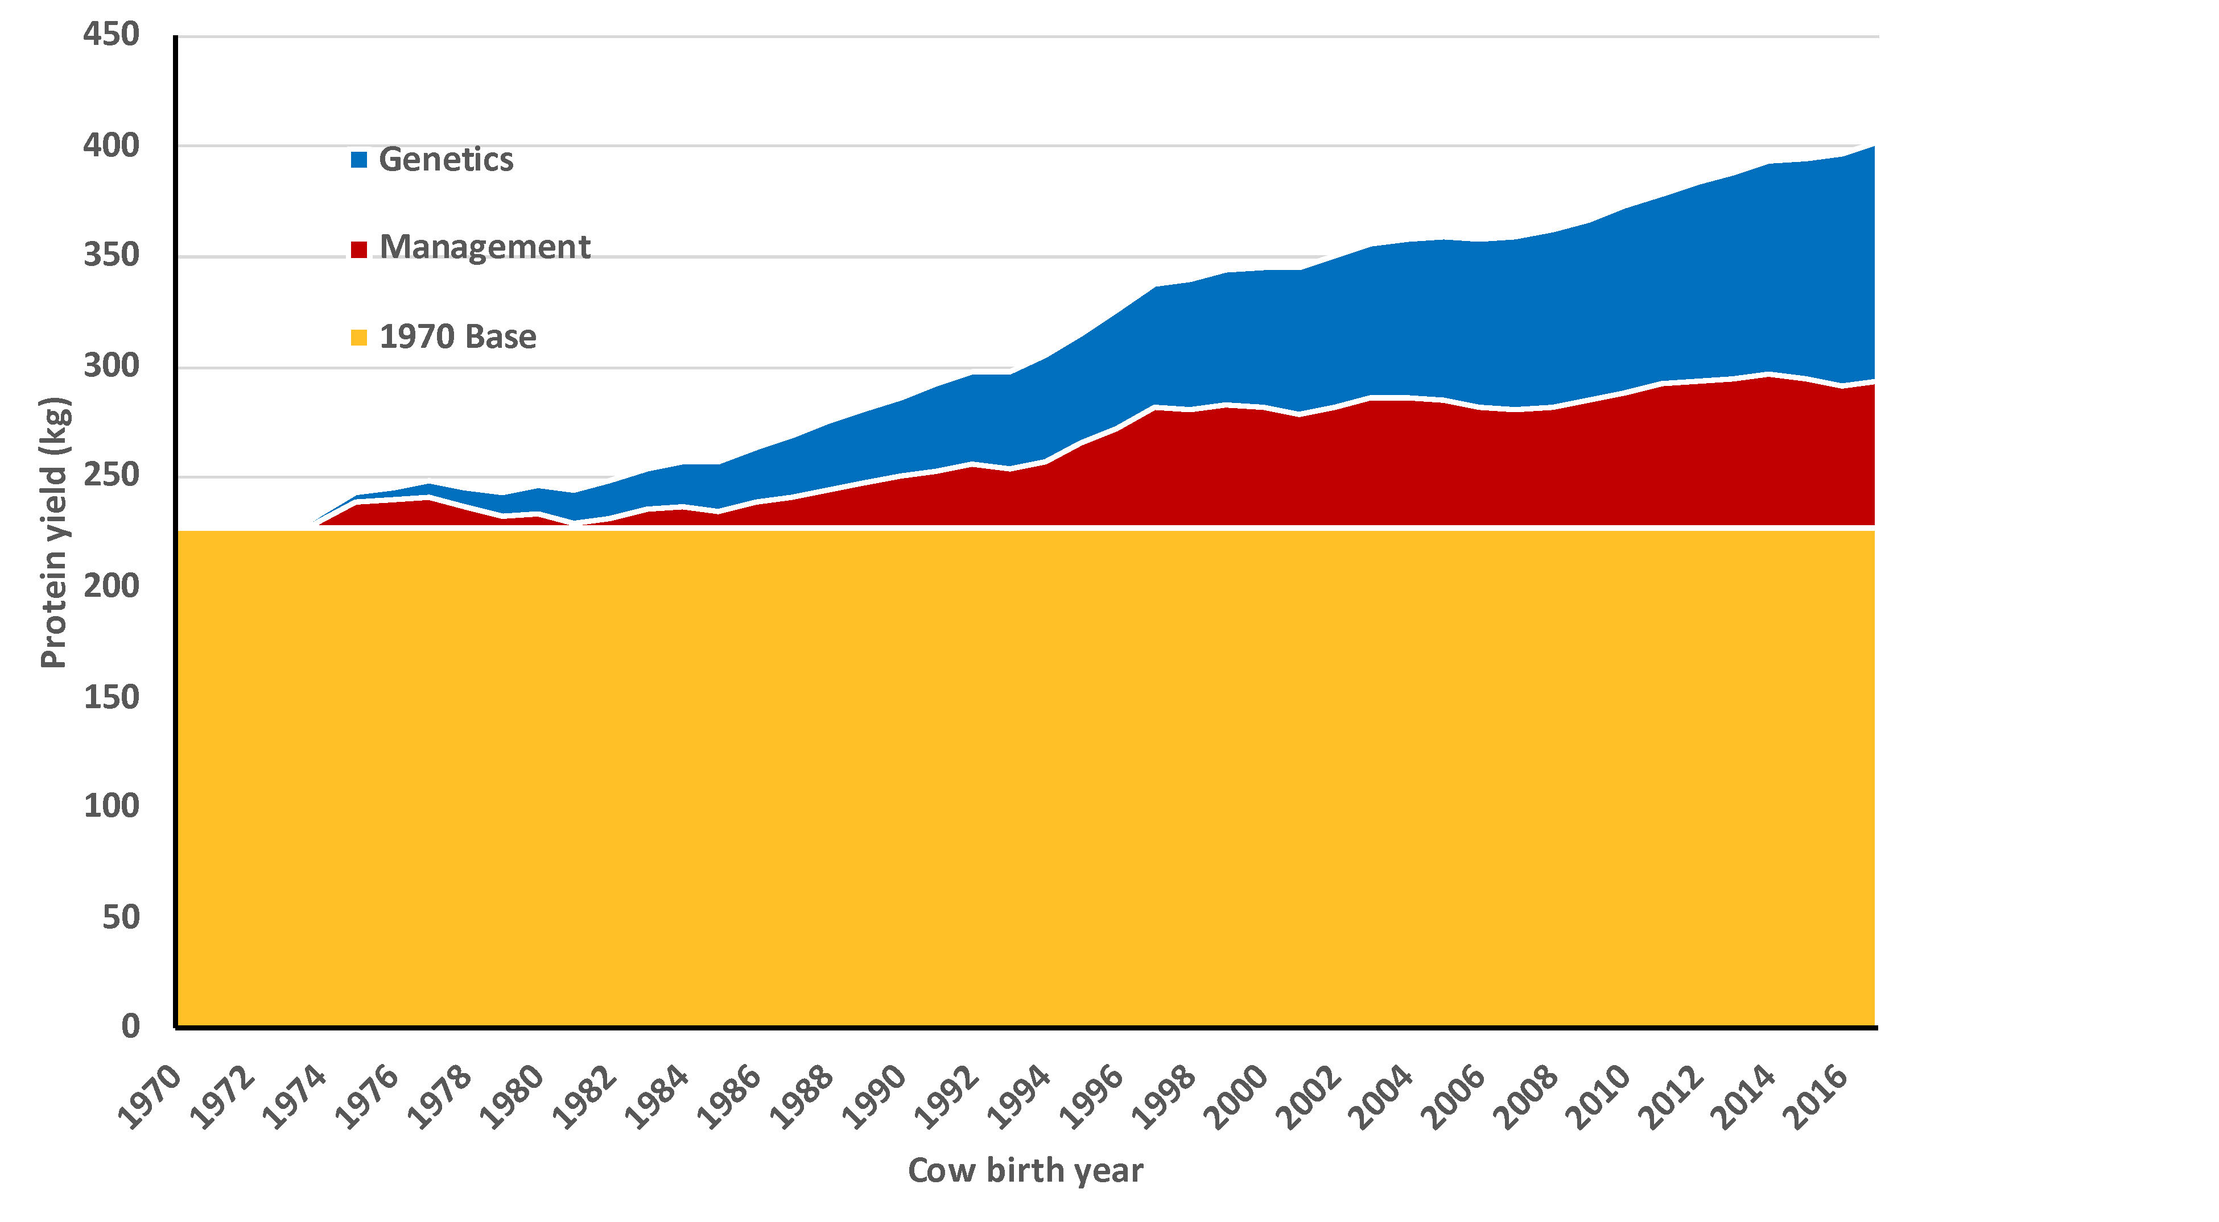
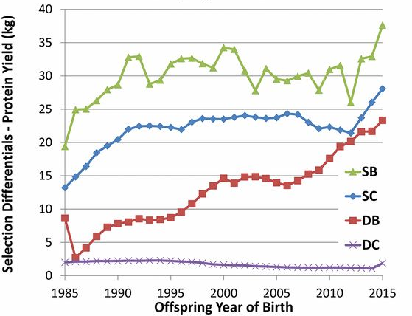
Production has increased steadily since the 1960s
Source: Cole et al. (2020)
Source: García-Ruiz et al. (2016)

Slide 4
Why do we need new phenotypes?
Changes in production economics
Technology produces new phenotypes or reduces costs of collecting them
  New traits can be predicted on all genotyped animals without collecting progeny records
  Phenotyping costs are shared among millions of animals
Better understanding of biology
Review by Egger-Danner et al. (2015; PMID: 25387784)

Slide 5

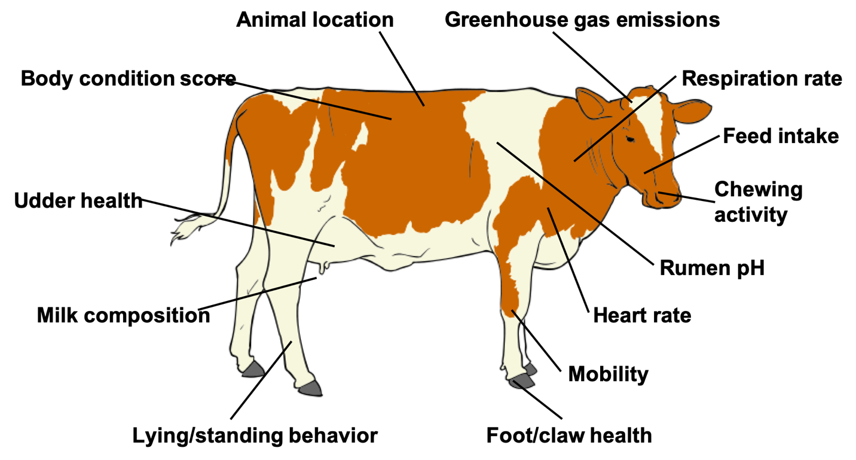
Phenotype is king!
Source: Cole et al. (2020; PMID: 32257602) after Figure 5 of Halachmi et al. (2019, PMID: 30485756).

Slide 6
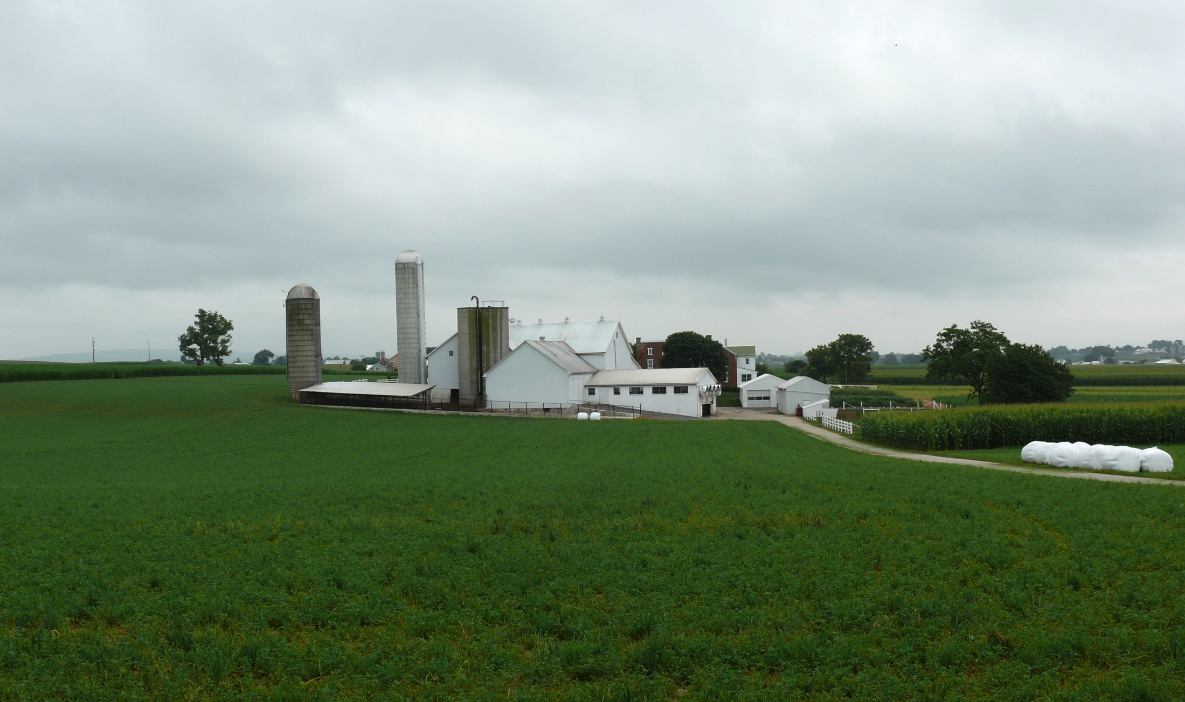
What about the outside of the cow?
Barn: Flooring type, bedding materials, density, weather data
Herdsmen/consultants: Health events, foot/claw health, veterinary treatments
Parlor: yield, composition, milking speed, conductivity, progesterone, temperature
Silo/bunker: ration composition, nutrient profiles
Pasture: soil type/composition, nutrient composition
Laboratory/milk plant: detailed milk composition, mid-infrared spectral data
Source: http://commons.wikimedia.org/wiki/File:Amish_dairy_farm_3.jpg

Slide 7
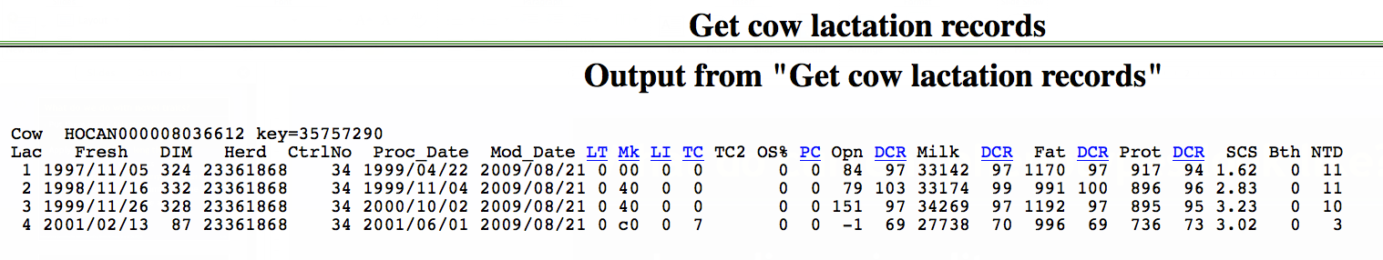
What do current phenotypes look like?
Low dimensionality
  Usually few observations per lactation
  Close correspondence of phenotypes with values measured
  Easy transmission and storage
  Costs of data recording are relatively low

Slide 8
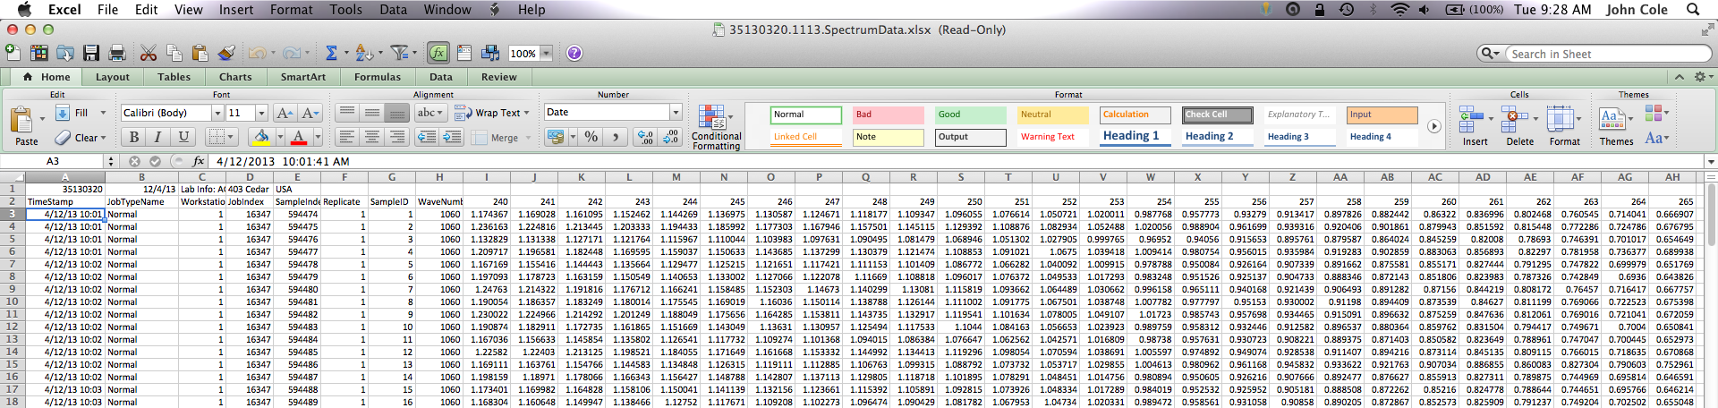
What do new phenotypes look like?
High dimensionality
  Example: MIR produces 1,060 points/observation
  Disconnect between trait and measurement
  More resources needed for transmission, storage, and analysis
  Phenotyping costs can be high (e.g., feed intake)

Slide 9
More traits, more problems?
Source: After Cole & VanRaden (2017; PMID: 29103719).

Slide 10
What are we actually trying to improve?
Feed Intake
Calves produced
CO₂ emission
Lifetime profit
“Efficiency”
Body size
Functional longevity
Live weight
Methane production
Income over feed cost
Mid-infrared milk spectrum
Body condition score
Microbiome

Slide 11
Do more data make prediction more difficult?
Genetic prediction
  Volume of data not a problem per se
  New data may need more complex models
  Causal inference remains challenging, but is needed to bridge gaps
  Advancements will be incremental
Phenotypic prediction
  Real-time or near-real-time calculation needed
  Data transfer speeds may be limiting
  Information may be siloed on the farm
  Collaboration with industry is critical!

Slide 12
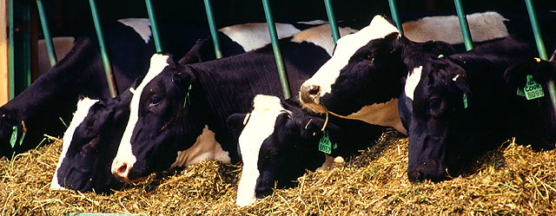
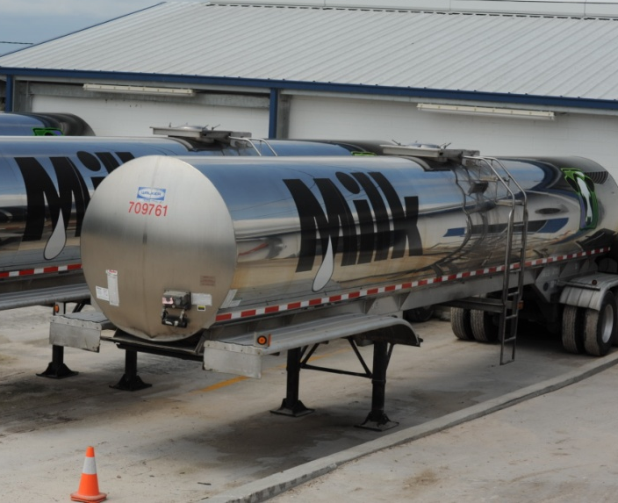
Traditional phenotyping scheme
Current milk recording
Many farms participate
Low-intensity phenotyping (few measurements per cow)
Well-suited to traits with low recording costs
Source: ARS, USDA
Source: North Florida Holsteins
Source: John B. Cole

Slide 13
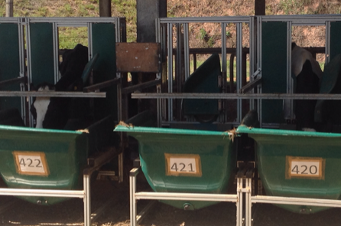
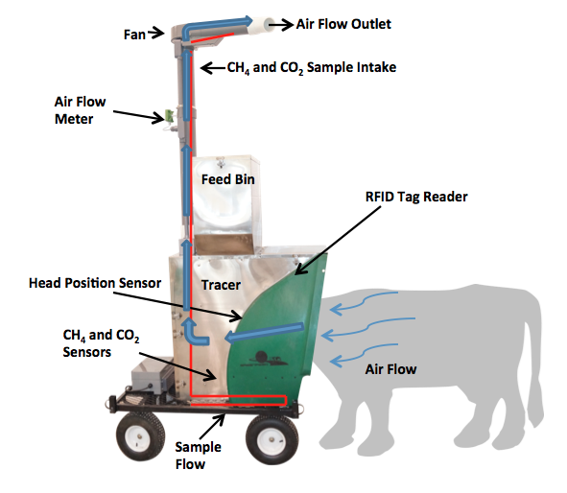
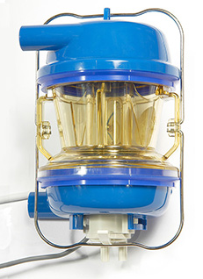
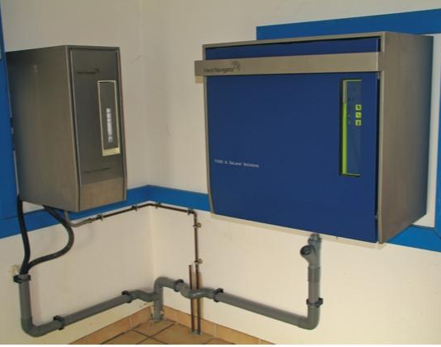
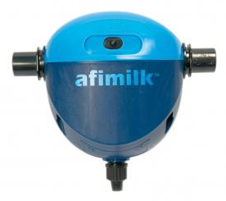
Alternative phenotyping scheme
Few farms
Intensive phenotyping (many measurements per cow)
Use cases
  Expensive-to-measure traits
  Developing countries
Source: John B. Cole
Source: http://c-lockinc.com/
Source: http://www.afimilk.com/
Source: http://goo.gl/wu8YtR

Slide 14
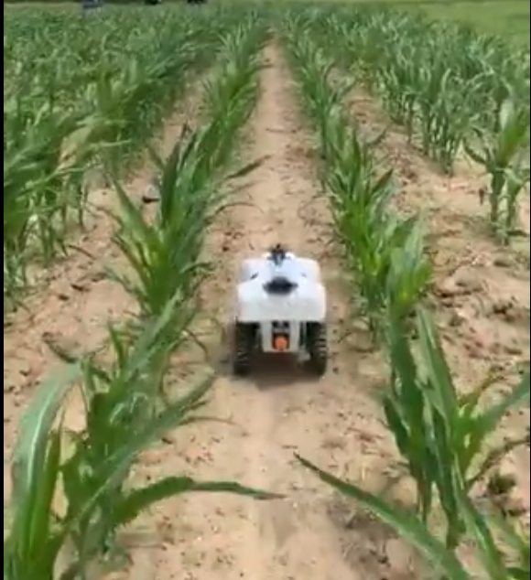

Next-generation automated phenotyping?
How I imagine it…
How it may turn out…
Source: Aimee Schulz (@aimeejschulz)
Source: Skaro Ministry of Science/BBC One

Slide 15
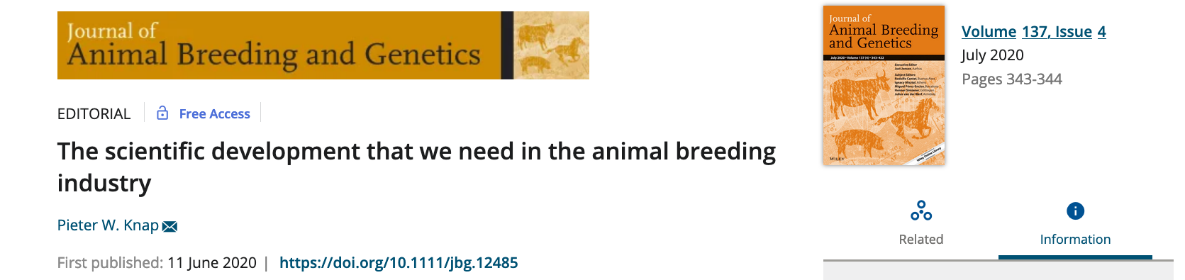
What else do we need to think about in the future?
Traits – we’ve already talked about that!
Methodology – needed to measure new things, do efficient calculations, and make decisions in a timely manner
Collaboration – needed to ensure that genetic potential is realized in an optimal environment

Slide 16
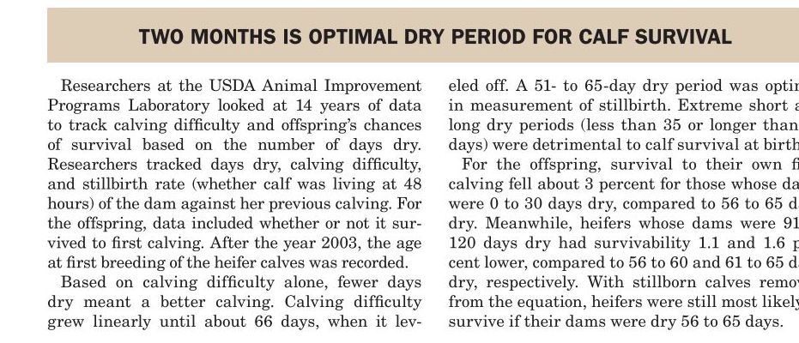
Example: Identification of best management practices
Optimal age at first calving
Source: Jersey Journal 64(11):17.
Best length of dry period
Source: Hoard’s Dairyman August 10, 2011 p. 480

Slide 17
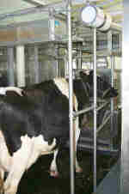
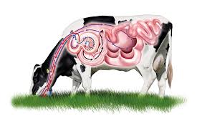
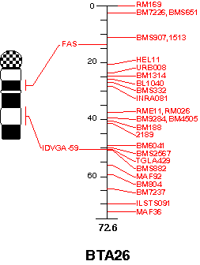
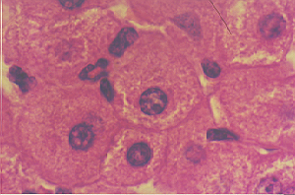
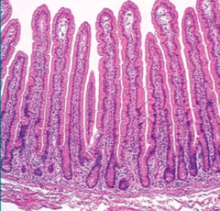
Example: Optimization of nutrient use by cattle
Animal Metabolism
Nutrient supply and use to support growth and milk production
Gut Metabolism
Uses 50% of animal energy
↑ Nutrient uptake to support production
Cellular/Molecular
Nutrient transport
Regulators of growth and metabolism
Genetics
Selectable markers for feed efficiency
Source: Erin E. Connor
Notes:
A part of the project stems from landmark work conducted by the Ruminant Nutrition Laboratory, which developed the basis for current dairy feeding programs in the U.S. Studies of whole animal calorimetry and nutrient use by specific body organs dating back to the 1980s showed that organs like the gut and liver are the greatest users of nutrients, and that inefficient feed use by the animal could be explained in large part by the growth of these organs. Thus one goal of the current project is understanding the control of nutrient uptake and growth of the gut as it relates to dairy cow feed efficiency using whole animal and in vitro models, and studies at the gene transcript and regulatory levels.

Slide 18
Final thoughts
If we want farmers to invest in these new technologies then there must be a way for them to earn their money back.
Supporting national milk recording programs in the future is a challenge as farms continue to grow bigger.
We should remain focused on producing healthful food as efficiently as possible for a growing population.
New analytics technologies will support that goal, but they need validation in real-world situations.

Slide 19
Disclaimer
Cole was supported by USDA-ARS project 8042-31000-002-00-D, “Improving Dairy Animals by Increasing Accuracy of Genomic Prediction, Evaluating New Traits, and Redefining Selection Goals”.
USDA is an equal opportunity provider and employer.
Mention of trade names or commercial products in this presentation is solely for the purpose of providing specific information and does not imply recommendation or endorsement by the US Department of Agriculture.

Slide 20
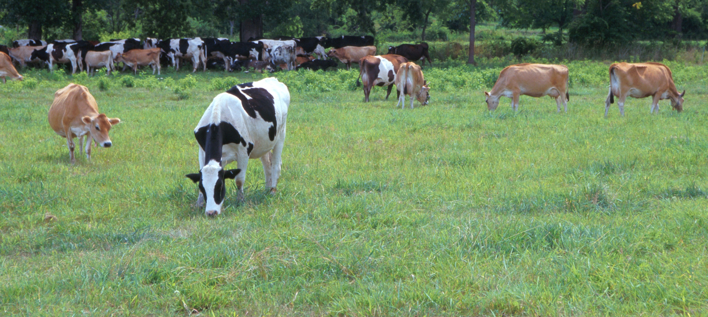
Questions?
AIP web site:
http://aipl.arsusda.gov/
Holstein and Jersey crossbreds graze on American Farm Land Trust’s
Cove Mountain Farm in south-central Pennsylvania
Source: ARS Image Gallery, image #K8587-14; photo by Bob Nichols

