Slide 1
Use of a threshold animal model to estimate calving ease and stillbirth (co)variance components for US Holsteins

Slide 2
Introduction
Easy calvings are associated with improved calf health
Lactations which begin with dystocia are at greater risk of post-partum disease
Dystocia and stillbirth are negatively associated with animal welfare and farm profitability

Slide 3
Current evaluations
Based on a sire-maternal grandsire (MGS) threshold model
Only bulls receive PTA which can be used to make selection decisions
Estimated reliabilities may not be very dependable
Not all modern tools support sire-MGS models very well

Slide 4
Trait definitions
Calving ease (CE) recorded on a five-point scale ranging from no assistance needed (most common) to extreme difficulty (least common)
Stillbirth (SB) coded as a binomial trait indicating whether or not the calf was alive 48 h postpartum

Slide 5
Records used for analyses
Official Calving Ease Extract
26,472,592 phenotypes
45,841,199 pedigree records
Official Stillbirth Extract
17,193,928 phenotypes
29,768,232 pedigree records
Edited Calving Ease Extract
17,390,453 phenotypes
30,238,767 pedigree records
S-MGS pedigrees
CE: 181,356
SB: 174,451
Edited Stillbirth Extract
11,453,510 phenotypes
19,803,132 pedigree records

Slide 6
More stringent edits
Records must have a valid dam ID and a known sire
Cows must have a corresponding lactation record
Breed composition must be at least 93.75% of the breed of evaluation

Slide 7
(Co)variance components estimation
Single-trait threshold animal model
Two datasets used: official calving traits data and new, stricter edits
Six samples of ~250,000 records drawn by sampling herd codes without replacement
Only Holstein data used for this study

Slide 8
Model for (co)variance componentss
thrgibbs1f90 version 2.108 (Tsuruta and Misztal, 2006)
100,000 samples drawn, first 10,000 discarded as burn-in
  Perhaps not enough?
Fixed: parity and sex of calf
Random: herd-year-season, animal (direct), maternal, maternal permanent environment, and residual error effects

Slide 9
Interpretation of (co)variances
Direct animal effects in animal models comparable to sire calving ease and sire stillbirth in S-MGS models
Maternal effects in animal models comparable to daughter calving ease and daughter stillbirth in S-MGS models
Every animal in the pedigree file receives an evaluation

Slide 10
Estimated (co)variance components
 | Calving Ease |  |  | Stillbirth
Component of variance | Official | New edits |  | Official | New edits
HYS | 0.6312 (0.07) | 0.7294 (0.14) |  | 0.1064 (0.007) | 0.0873 (0.005)
Direct | 0.2679 (0.02) | 0.3233 (0.07) |  | 0.0546 (0.002) | 0.0370 (0.004)
Maternal | 0.0997 (0.02) | 0.1118 (0.02) |  | 0.0467 (0.002) | 0.0572 (0.006)
Cov(D,M) | 0.0387 (0.02) | 0.0489 (0.04) |  | 0.0083 (0.002) | 0.0164 (0.002)
Maternal PE | 0.1604 (0.02) | 0.2364 (0.06) |  | 0.0731 (0.003) | 0.0373 (0.007)
Residual | 1.8558 (0.21) | 2.0667 (0.32) |  | 1.0000 (0.000) | 1.0000 (0.000)
Direct h² | 0.09 (0.01) | 0.09 (0.02) |  | 0.03 (0.002) | 0.03 (0.003)
Maternal h² | 0.03 (0.01) | 0.04 (0.01) |  | 0.04 (0.001) | 0.05 (0.005)

Slide 11
Summary of (co)variance components
Heritabilities similar for S-MGS and animal models
Maternal heritabilties slightly lower in animal model
Maternal heritabilities slightly higher using new edits
  Possibly due to larger estimates of direct-maternal covariances

Slide 12
Breeding value estimation
Single-trait threshold animal model using estimated (co)variances
cblup90iod version 2.33 (Misztal et al., 2002)
  This is an OLD version (3.21 is current)
Results from current sire-MGS compared to animal model
  ~3,000 bulls with reliabilities of at least 90%

Slide 13
Runtime for estimated breeding values
Trait¹ | Scenario | Start date | End date² | Time (d) | Rounds
CE | Official | 06/06/16 | N/A | N/A | 882
 | Edited | 06/06/16 | N/A | N/A | 1,362
 | Official (UPG) | 06/06/16 | N/A | N/A | 873
 | Edited (UPG) | 06/06/16 | 07/01/16 | 25 | 828
SB | Official | 05/16/16 | 05/26/16 | 10 | 479
 | Edited | 05/16/16 | 05/16/16 | 0.5 | 33
¹CE = calving ease, SB = stillbirth.
²N/A = not available.

Slide 14
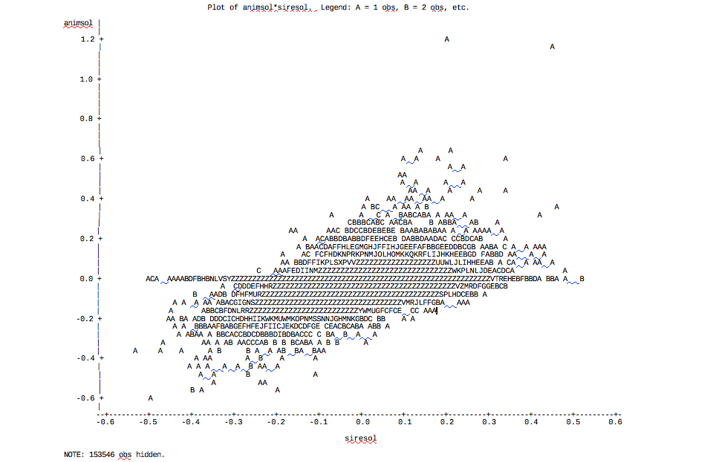
Calving ease – edited data (UPG)
Direct
N = 4,622
r_{Pearson} = 0.45
r_{Spearman} = 0.32
Maternal
N = 3,237
r_{Pearson} = 0.40
r_{Spearman} = 0.29

Slide 15
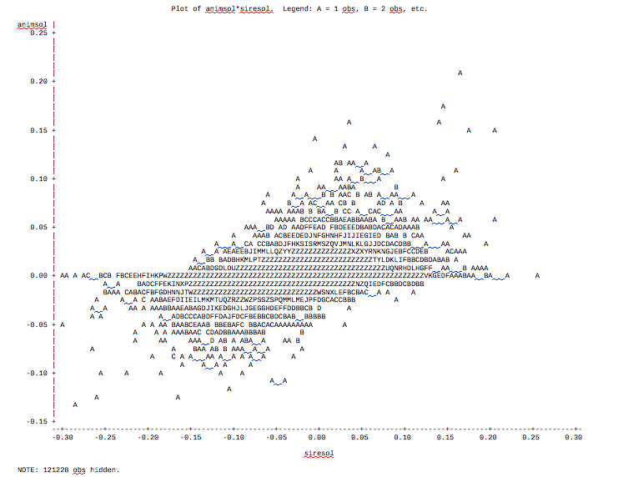
Stillbirth – official data
Direct
N = 4,099
r_{Pearson} = 0.48
r_{Spearman} = 0.53
Maternal
N = 1,750
r_{Pearson} = 0.62
r_{Spearman} = 0.55

Slide 16
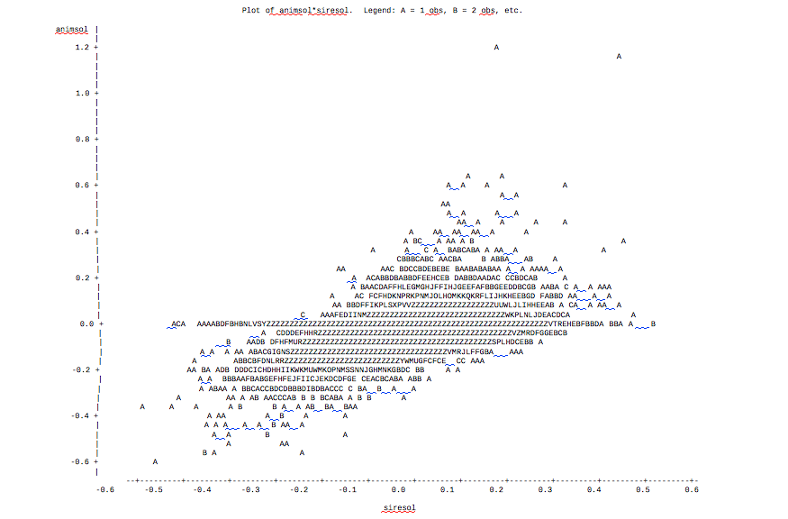
Stillbirth – edited data
Direct
N = 4,622
r_{Pearson} = 0.45
r_{Spearman} = 0.32
Maternal
N = 3,237
r_{Pearson} = 0.39
r_{Spearman} = 0.29

Slide 17
Challenges
Unexpectedly long run-times
  It is not clear why so many rounds of iteration are required
  Newer versions of software might help
Lower-than-anticipated correlations of underlying scale solutions from sire-MGS and animal models
Unknown parent groups may be a problem

Slide 18
Conclusions
The threshold animal model needs refinement before it is suitable for use in the US dairy population
Runtime must be reasonable for use in routine evaluation
Low correlations of S-MGS with animal model evaluations must be explained before recommendation to industry

Slide 19
Acknowledgments
Appropriated project 1265-31000-096-00, "Improving Genetic Predictions in Dairy Animals Using Phenotypic and Genomic Information", ARS, USDA
Council on Dairy Cattle Breeding

Slide 20
Disclaimer
Mention of trade names or commercial products in this presentation is solely for the purpose of providing specific information and does not imply recommendation or endorsement by the US Department of Agriculture.

Slide 21

Questions?
http://gigaom.com/2012/05/31/t-mobile-pits-its-math-against-verizons-the-loser-common-sense/shutterstock_76826245/

